Slide 1
LARA
DB
⋈
⊕
⊗
A Minimalist Kernel for
Linear and Relational Algebra
Dylan Hutchison, Bill Howe, Dan Suciu
BeyondMR @SIGMOD, 19 May 2017
Contact: dhutchis@cs.washington.edu

Slide 2
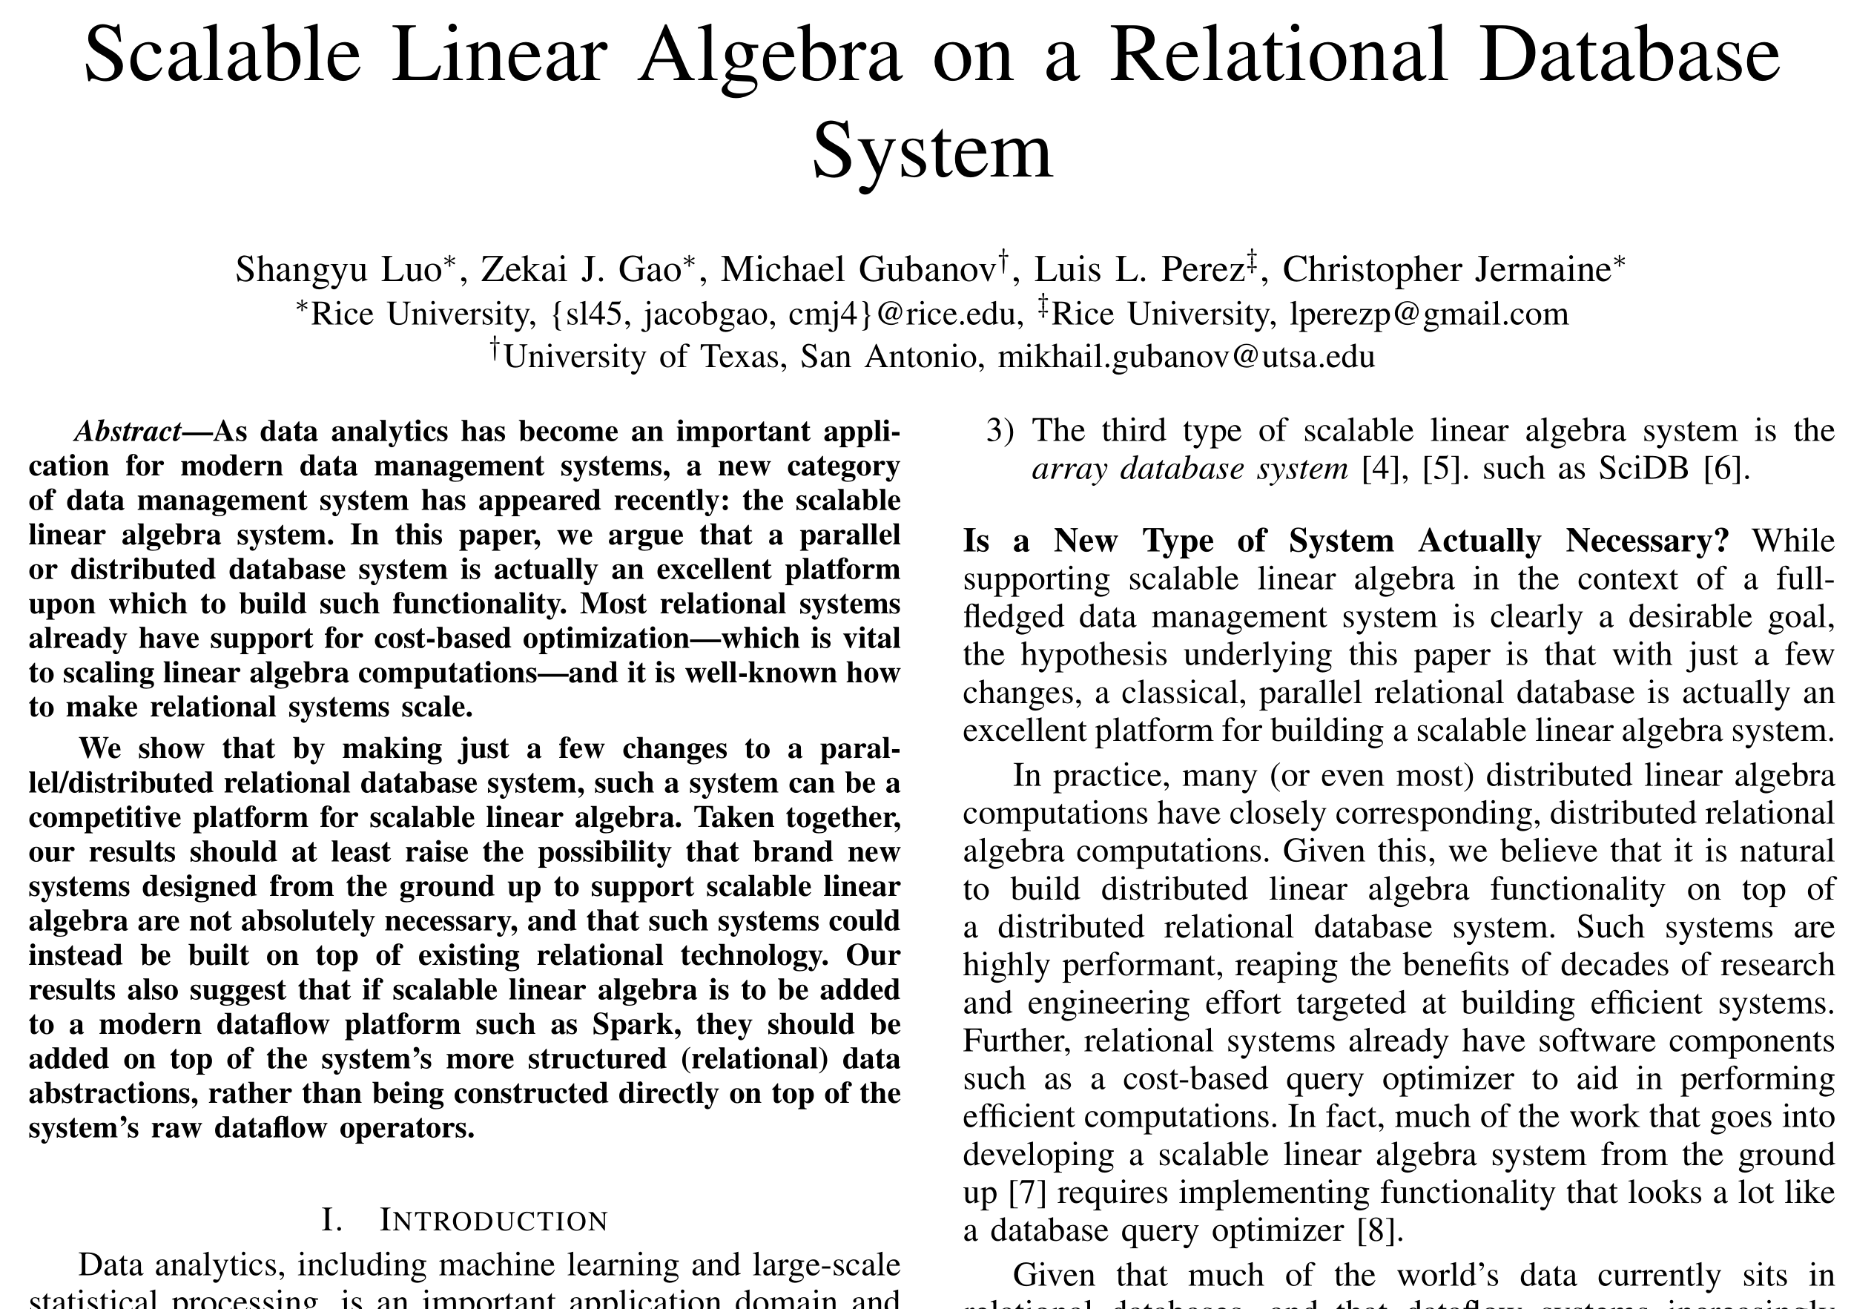
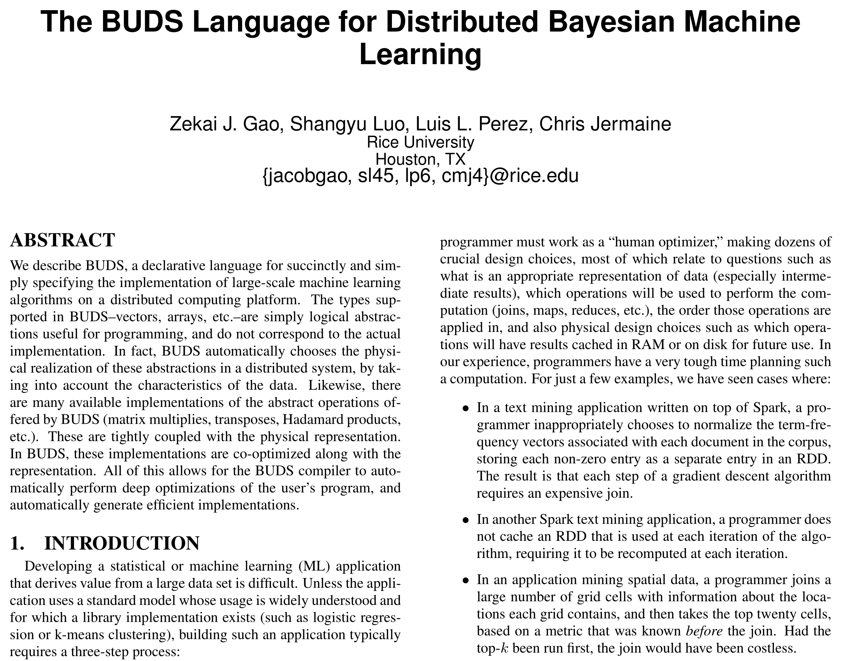
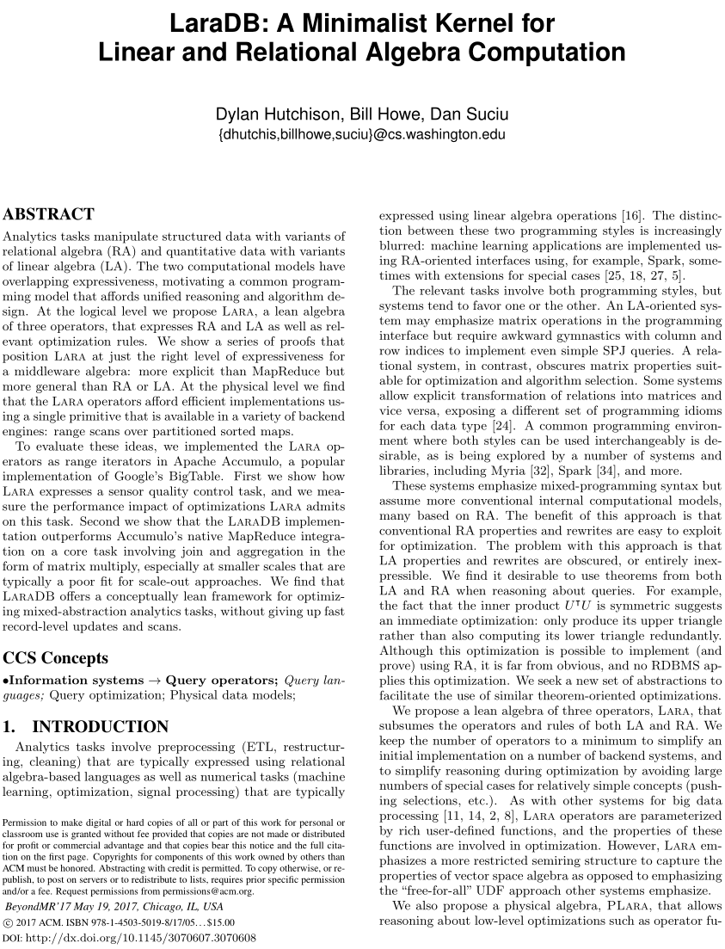
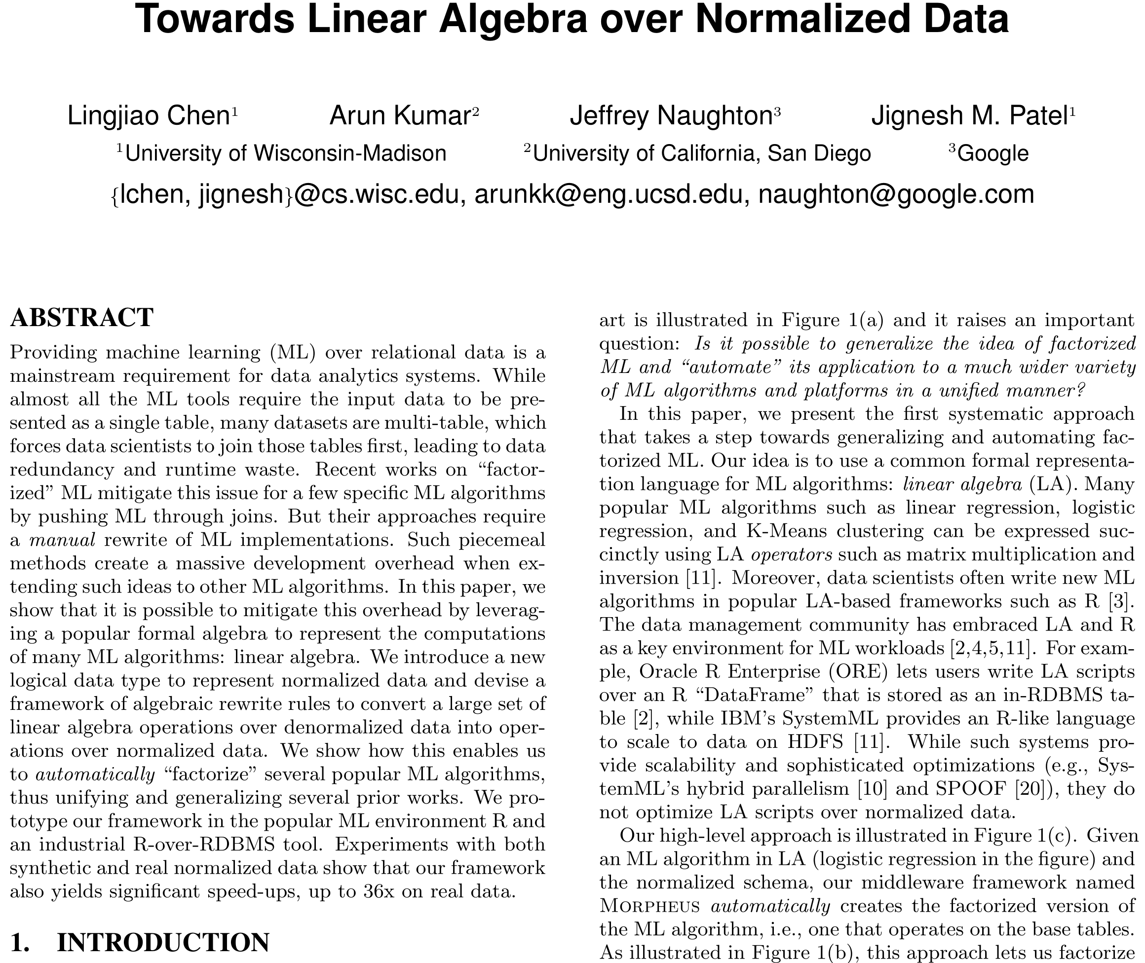
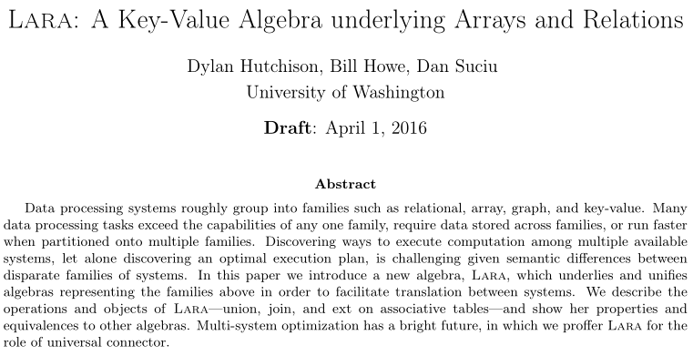
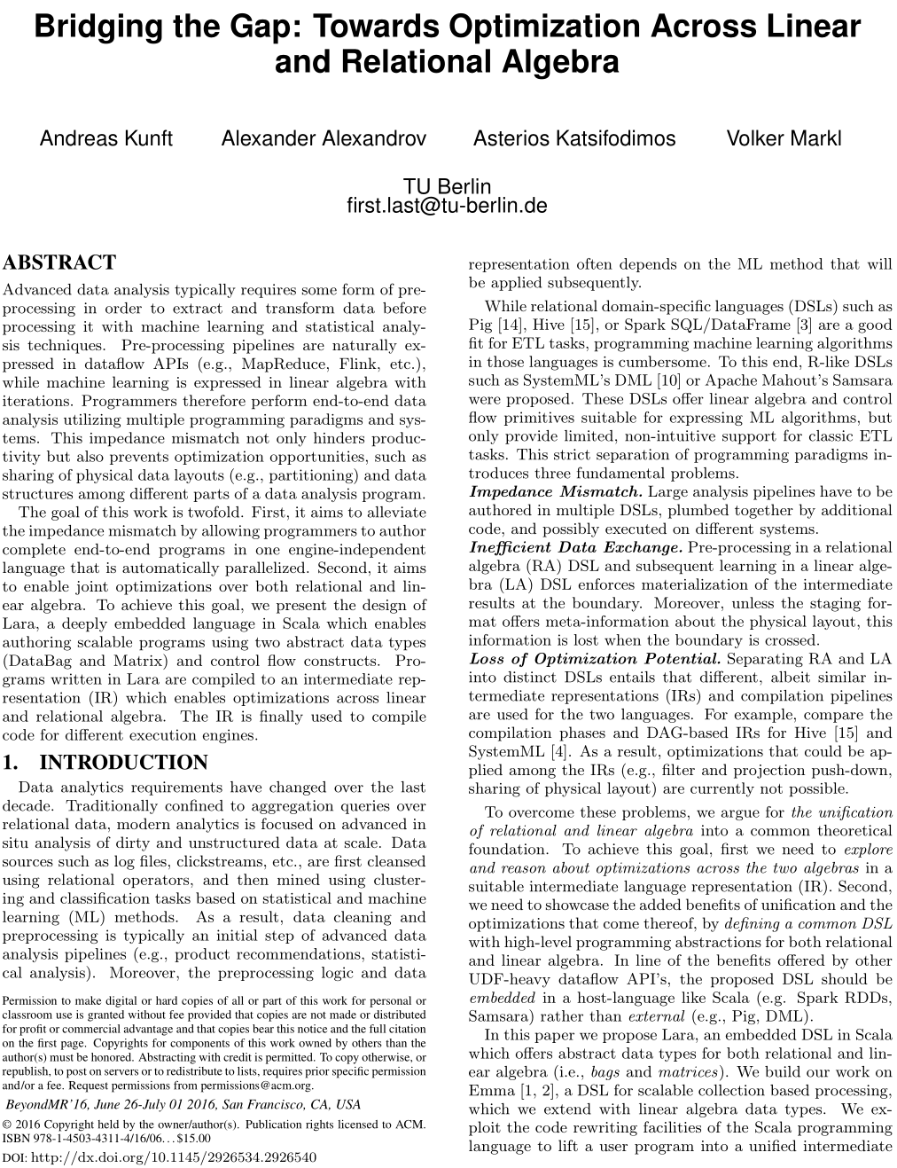
Related Work
2017
2017
LaraDB
Sensor Query on Array of Things data
Logical + Physical Algebra
Properties / Optimizations
LaraDB Implementation
Experiments
Extend SQL with LA types, UDFs on SimSQL
Compile MATLAB-like LA to SQL in BUDS
Morpheus: Push LA into matrix multiply for ML
2016
Logical Algebra
Properties / Optimizations
Translations
Vision paper
Hypothetical Sensor Query
Properties / Optimizations
Notes:
Before we jump into content, I’d like to give you some context.
In 2016, two papers were published. The first is a technical report on the Lara algebra, and the second is a TU Berlin paper, which you may remember from last year’s BeyondMR conference. The technical report introduced a logical algebra, and the BeyondMR paper laid a vision using a sensor example as motivation.
I was excited to see the BeyondMR work, which believe it or not, independently coined the term Lara.
It inspired me to make their sensor example real with urban data.
Today’s work does just that plus several other contributions, and we’ll cover them all in our talk today.
But before I move into motivation via the sensor example, I’d like to show you that the topic of combining LA and RA is a hot topic.
More related work popped up this year in SIGMOD, VLDB, and as an ICDE best paper.
These works involve relating LA to SQL, as well as exploiting the properties of LA to optimize a ML context.
In contrast to these, the work we do here is to propose a new algebra, Lara, that translates to and from LA and RA and exploits the properties of both.

Slide 3
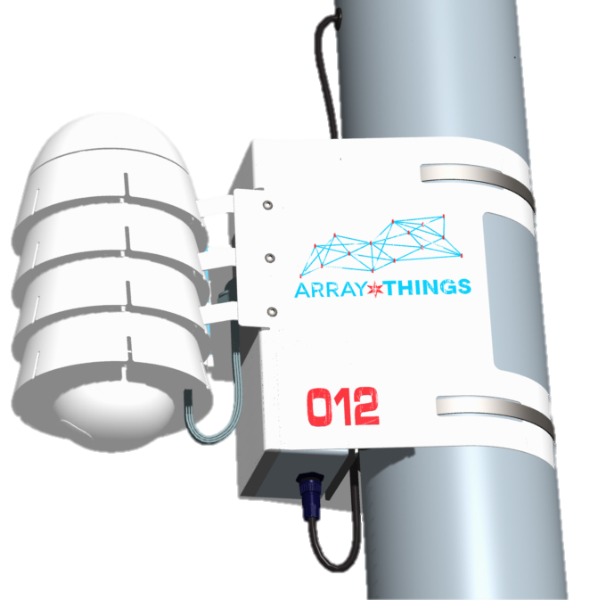


Motivating Use Case: Mean & Covariance of sensor differences
Array of Things
Sensor Data
t | c | v
466 | temp | 55.2
466 | hum | 40.1
492 | temp | 56.3
492 | hum | 35.0
528 | temp | 56.5
Filter, bin onto common time buckets
Filter, bin onto common time buckets
Preprocessing
(easier to express in RA)
Impedance Mismatch?
Subtract
Collected in CSV files
Analysis
(easier to express in LA)
Compute Mean
Compute Covariance
https://arrayofthings.github.io/
Notes:
Here is that sensor example I mentioned. The data for this query comes from the Array of Things urban data project, which actually began in this very city of Chicago. You might even see one of these sensors on a nearby telephone pole.
These sensors regularly record environmental measurements such as temperature, humidity, magnetism, and more, as shown in this example table.
The task we focus on is to compute the mean and covariance of the differences in the measurements of two sensors.
As you can see from the example, the query involves a preprocessing phase that is easier to express in RA, and an analysis phase that is easier to express in LA.
This creates a possible impedance mismatch between code written in the two paradigms.
Let’s examine why.
Array of Things sensor data from Argonne National Labs. First started as a project with the city of Chicago.
Suppose we have two such sensors and we wish to study the differences in their measurements. We would like to know what the mean differences are and how the measurement types covary. For example, when the first sensor records a higher temperature than the second, does that correlate with a larger humidity measurement as well?
Calibration, compare newly manufactured sensor to the golden standard

Slide 4
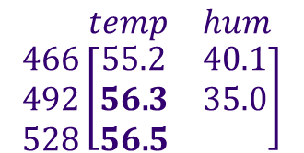
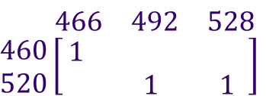
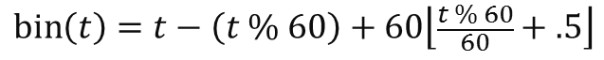
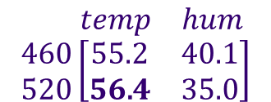
Bin query: easy in RA, awkward in LA
t | c | v
466 | temp | 55.2
466 | hum | 40.1
492 | temp | 56.3
492 | hum | 35.0
528 | temp | 56.5
t’ | c | v
460 | temp | 55.2
460 | hum | 40.1
520 | temp | 56.4
520 | hum | 35.0
RA
select bin(t) as t', c, avg(v) as v
group by t', c
LA
Multiply:
using avg on added elements
$$\begin{matrix} & temp & hum\end{matrix} \\ \begin{matrix}466 \\ 492 \\ 528\end{matrix}\left[\begin{matrix}55.2 & 40.1 \\ 56\text{.}3 & 35.0 \\ 56\text{.}5 & \end{matrix}\right]$$
$$\begin{matrix} & 466 & 492 & 528\end{matrix} \\ \begin{matrix}460 \\ 520\end{matrix}\left[\begin{matrix}1 & & \\ & 1 & 1 \end{matrix}\right]$$
$$\begin{matrix} & temp & hum\end{matrix} \\ \begin{matrix}460 \\ 520\end{matrix}\left[\begin{matrix}55.2 & 40.1 \\ 56\text{.}4 & 35.0\end{matrix}\right]$$
*
=
$$\text{bin}\left(t\right)=t−\left(t \% 60\right)+60\left\lfloor \frac{t \% 60}{60}+.5\right\rfloor$$
Notes:
Here is a simple bin query from the example. It averages values into bins of 60 second lengths.
You all know how to write this query in SQL, and relational optimizers know how to optimize it.
If we wanted to write the query in LA instead, we could realize the data as matrices, and come up with a matrix for the bin function so that we could multiply it with the original to obtain our result. The procedure works, but it’s clear that RA is a better approach.
Problems: Matrix needs indexing set; LA doesn’t typically have methods to transform indices like this. LA operators works well when transforming the values. Matrix is infinite in general
Assoc(bin(Row(A)), Row(A), 1) *_avg A

Slide 5
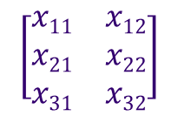
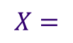
Covariance query: easy in LA, awkward in RA
$$\left[\begin{matrix}x11 & x12 \\ x21 & x22 \\ x31 & x32\end{matrix}\right]$$
$$X=$$
LA
N = size(X, 1);
M = mean(X, 1);
C = X'*X / N – M'*M;
RA
(Generated SQL statements for each entry)
T = select from X sum(1.0) as N,
sum(X₁) as M₁, sum(X₂) as M₂, …, sum(X_{d}) as M_{d},
sum(X₁*X₁) as Q₁₁, sum(X₁*X₂) as Q₁₂, …,
sum(X_{d-1}*X_{d}) as Q_{(d-1)d}, sum(X_{d}*X_{d}) as Q_{dd}
C = select from T
(1 as i, 1 as j, Q₁₁/N – M₁*M₁ as v) union
(1 as i, 2 as j, Q₁₂/N – M₁*M₂ as v) union
…
Carlos Ordonez.
Building Statistical Models and Scoring with UDFs. SIGMOD 2007.
Notes:
Here is a covariance query on a data matrix. The LA math equations for covariance are simple, and languages like MATLAB realize them directly.
If we wanted to realize a covariance calculation in SQL instead, we would need to use techniques from a series of SIGMOD papers that generate large SQL queries like this.
Clearly the LA approach is the way to go.
Mean $M=\frac{1}{n}1^{T}X$ Covariance $C=\frac{1}{n}X^{T}X−M^{T}M$
This approach stores each column of the matrix X as a separate attribute.
Another approach is (I, j, v). We could use Lara to write the equations for this.
To prove that the MATLAB implements the LA, use: 1/n * (X – 1M)^{T}(X – 1M) = 1/n * X^{T}X – M^{T}M
Use n/(n-1) for bias correction.
U = X - repmat(M, N, 1);
C = U.' * U ./ (N - 1);
Bessel’s Correction for sample variance: N/(N – 1)

Slide 6
Properties, easier in LA or RA
(A^{T}A)^{T} = A^{T}A [inner product is symmetric]
RA version is verbose (renames, joins, aggregates)
Impact: eliminate half of computation
A ⋈_{i} B = σ_{i=i} (A ⨉ B) [cross product to join]
LA version is verbose (tensor products and contractions)
Impact: eliminate large intermediates
Notes:
Finally here are a couple simple properties in LA and RA.
The first is a symmetric property that is self-evident in LA and impactful, yet verbose in RA.
The second is a join definition that is self-evident in RA and impactful, yet requires higher-order tensor operations in LA.

Slide 7
Is a common algebra possible?
Evidence:
Overlapping expressiveness
Matrix Multiply = GroupBy ○ Apply ○ Join
Emergence of hybrid systems
Spark, Myria, MADlib, SystemML, Weld, …
Systems with RA and LA interfaces or data models
Notes:
So with the previous evidence that there are tasks and properties that RA works well for but not LA and vice versa, could we even hope to unite these algebras?
The answer is yes, of course, because we all know that RA and LA have overlapping expressiveness, such as how MxM can be rewritten as a group-by-join.
We’ve also seen a surfeit of hybrid systems that have RA and LA aspects.

Slide 8
LARA
Roadmap
⋈
⊕
⊗
Motivation: Sensor query
Sometimes RA is better, sometimes LA
Lara Algebra
3 Operators & Properties
LaraDB on Sorted Distributed Maps
Physical operators & optimizations
Experiments
Optimizations: Lara affords impactful optimizations
Performance: Lara affords competitive performance
Notes:
With that, we will now move our discussion onto the Lara algebra.
We’ll then present the setting of Sorted Distributed Maps, for which we lowered Lara to a physical algebra implemented in the Accumulo database.
Finally we’ll cover two experiments that show how a Lara implementation can afford impactful optimizations and competitive performance.

Slide 9
LARA
Attributes
⋈
Keys
Values
⊕
⊗
k₁ | k₂ | [0] v₁ | [‘’] v₂
a | 37 | 7 | ‘dan’
a | 20 | 0 | ‘’
b | 25 | 0 | ‘dylan'
b | 20 | 2 | ‘bill’
Default Values
Objects: Associative Tables
Each row is a tuple
Total functions from keys to values with finite support
Support
Operators:
Join
Union
Extension
⋈⊗
⋈
ext_{f}
Parameterized by
UDFs: ⊗, ⨁, f
⨁
“join keys, multiply values”
“group by keys, add values”
“flatmap”
Join and Union adapted from:
M. Spight and V. Tropashko.
First steps in relational lattice. 2006.
Ext is similar to monadic bind, without deleting keys
Notes:
Now for the algebra. We start with Lara’s objects and operators.
Its objects are called associative tables. These are total functions with finite support from a space of keys to a space of values.
We write them as tables like this that show the mappings from particular keys to particular values. Each row is called a tuple.
The keys not listed in the table map to default values, indicated in the brackets above, in this case 0 and the empty string.
The support of an associative table is the set of keys that map to non-default values.
Lara has three operators. Each one is parameterized with a UDF.
The 1st is join, which is like a horizontal join on keys while multiplying values with a times function.
The 2nd is union, which is like a group by and union on keys that aggregates over values with a plus function.
The 3rd is ext, which is like a flatmap with the function f. For those of you unfamiliar, a flatmap is a function that acts on each tuple independently and produces a set of new tuples, which are in turn unioned together into the result.
We will now go over each one of these operators in detail.
‘I want you to think of join and union as a kind of semiring, with their times and plus functions. You might also think of join as horizontally concatenating associative tables together, while union vertically concatenates tables together. You can think of ext as flatmap: it takes a function f which operates on a tuple and emits multiple tuples, which are then unioned together.
Let’s cover these in more detail.
Two syntaxes: COBOL/SQL-style for writing scripts, algebraic/combinatory-style for proofs.
Flatmap is monotonic in key type.
⨁ has default values as identity;
⊗ has default values as annihilator

Slide 10
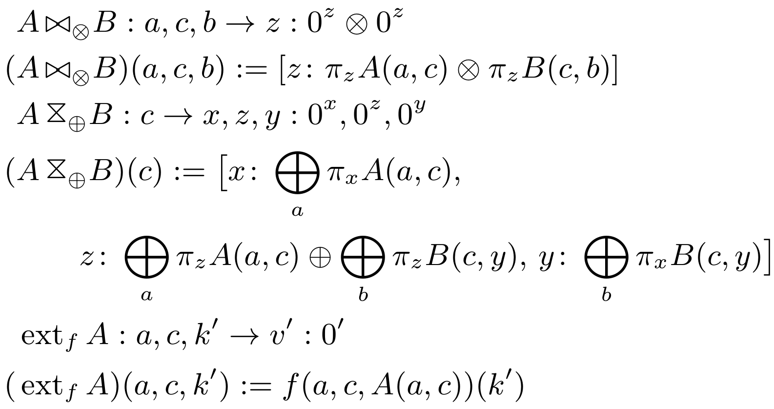
Join with ⊗: Join keys, multiply values
c | b | [0] z | [0] y
a | c | [0] x | [0] z
c | b | [0] z | [0] y
c₁ | b₁ | 5 | 15
c₂ | b₁ | 6 | 16
c₂ | b₂ | 7 | 17
c₄ | b₁ | 8 | 18
a | c | [0] x | [0] z
a₁ | c₁ | 11 | 1
a₁ | c₂ | 12 | 2
a₂ | c₁ | 13 | 3
a₃ | c₃ | 14 | 4
a | c | b | [0 ⊗ 0 = 0] z
a₁ | c₁ | b₁ | 1 ⊗ 5
a₁ | c₂ | b₁ | 3 ⊗ 5
a₁ | c₂ | b₂ | 2 ⊗ 6
(a₃ | c₃ | b₁ | 4 ⊗ 0 = 0)
a | c | b | [0 ⊗ 0 = 0] z
⋈⊗
=
Requires (see paper for general case): v_{A} ⊗ 0 = 0 ⊗ v_{B} = 0 ⊗ 0 = 0
Notes:
Here is an example of join. To understand what join is doing, first look at the types. Union of keys, intersection of values.
The values of the result table, for every (a,c,b) key, are defined as the multiplication of the values from the input tables on their part of the key.
For example, [[ a1, c1, b1 ]].
These also apply to the default values [[ ]]
For example, [[ a3, c3, b1 ]]
Finally, remember that join can take any multiply function, even something like subtraction, as long as it has the default values as annihilators.
There are some restrictions on the multiply function to ensure the result has finite support, but we’ll skip those for now.
Multiply matching values by UDF ⊗s, one for each value attribute
Each ⊗ has default value as annihilator: v_{A} ⊗ 0' = 0 ⊗ v_{B} = 0 ⊗ 0'
Keys: $=K_{A}∪K_{B}$
Values: $=V_{A}∩V_{B}$
Support: $⊆S_{A}∩S_{B}$ (on common keys), with equality when ⊗ has zero product property

Slide 11
Union with ⨁: Group by keys, sum values
c | b | [0] z | [0] y
c | b | [0] z | [0] y
c₁ | b₁ | 5 | 15
c₂ | b₁ | 6 | 16
c₂ | b₂ | 7 | 17
c₄ | b₁ | 8 | 18
c | [0] x | [0 ⨁ 0 = 0] z | [0] y
a | c | [0] x | [0] z
c | [0] x | [0 ⨁ 0 = 0] z | [0] y
c₁ | 11 ⨁ 13 | 1 ⨁ 3 ⨁ 5 | 15
c₂ | 12 | 2 ⨁ 6 ⨁ 7 | 16 ⨁ 17
c₃ | 14 | 4 | 0
c₄ | 0 | 8 | 18
a | c | [0] x | [0] z
a₁ | c₁ | 11 | 1
a₁ | c₂ | 12 | 2
a₂ | c₁ | 13 | 3
a₃ | c₃ | 14 | 4
⋈
=
⨁
Requires: v ⨁ 0 = 0 ⨁ v = v
Notes:
The values of the result table are the aggregation of all input tuples with matching key.
Sum colliding values by UDF ⨁s, one for each value attribute
Default values must match
Each ⨁ has default value as identity: v ⨁ 0 = 0 ⨁ v = v
Agg: special case when one table is empty
example: aggregates down to key i
Keys: = 𝐾_{𝐴} $∩$ 𝐾_{𝐵}
Values: = 𝑉_{𝐴} ∪ 𝑉_{𝐵}
Support: ⊆ 𝑆_{𝐴} ∪ 𝑆_{𝐵} (on common keys), with equality when ⨁ is zero-sum-free

Slide 12
docid | word | [0] value
docid | word | [0] value
d₁ | she | 1
d₁ | sells | 1
d₁ | sea | 1
d₁ | shells | 1
d₁ | by | 1
d₁ | the | 1
d₁ | shore | 1
docid | word | [0] value
d₁ | she | 1
d₁ | sells | 1
d₁ | sea | 1
d₁ | shells | 1
d₁ | by | 1
d₁ | the | 1
d₁ | shore | 1
d₂ | the | 1
d₂ | shells | 1
d₂ | she | 1
d₂ | sells | 1
d₂ | are | 1
… | … | …
Ext with f: Flatmap
docid | [‘’] text
d₁ | she sells sea shells by the sea shore
d₂ | the shells she sells are surely seashells
ext_{f}
=
f(docid, text) =
text.split(‘ ’)
.groupBy(word)
Produces new key ‘word’
Requires that f behave same on default value input
Notes:
Ext takes a function operates on each tuple individually and may produce new keys. These keys are appended to old keys.
In this example, the UDF function f is the TOKENIZE function. It places each unique word as a key and maps it to the value 1.
The result table is produced by concatenating the output of f on each input tuple.
For example, when we run f on the first tuple, we get these entries in the first table. Notice we retain the original document ID.
The same thing happens for the 2nd tuple, and we concatenate the results together.
If, as an extention, we wanted to get rid of the document identifier, we would use a union operation to do that.
Run f on each row independently, replaces values
Appends new keys (never deletes)
Monotonic in key type; no collisions
No free variables
Use Join/Union to interface with external tables
Requirement for finite support:
Map: special case when k' = ()
Rename: map that changes attribute names
RA: CROSS APPLY
LA: EXPLODE

Slide 13
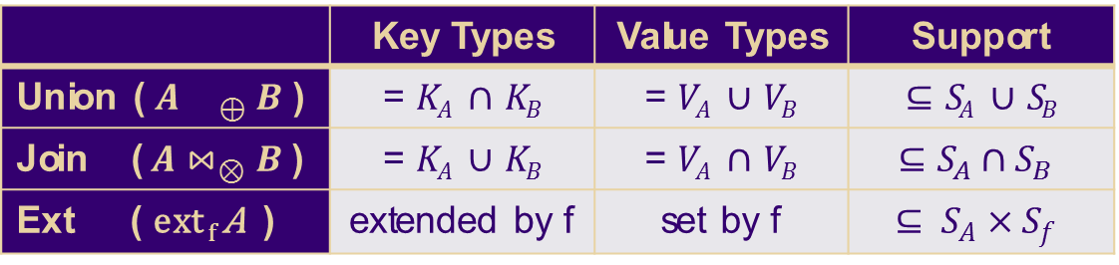

Summary: Union, Join, Ext
 | Key Types | Value Types | Support
Union ($A{ }_{⊕} B$ ) | = 𝐾_{𝐴} $∩$ 𝐾_{𝐵} | = 𝑉_{𝐴} ∪ 𝑉_{𝐵} | ⊆ 𝑆_{𝐴} ∪ 𝑆_{𝐵}
Join ( $A⋈_{⊗}B$ ) | = 𝐾_{𝐴} $∪$ 𝐾_{𝐵} | = 𝑉_{𝐴} $∩$ 𝑉_{𝐵} | $$⊆S_{A}∩S_{B}$$
Ext ( ext _{f} A ) | extended by f | set by f | $$⊆ S_{A}×S_{f}$$
$$⋈$$
Duality
For Support, ‘⊆’ becomes ‘=’ if ⊕ is zero-sum-free or ⊗ has zero-product-property (similar for f)
Notes:
Here I’ve summarized the key structural properties of join, union, and ext.
Notice that union and join have dual roles in their types; this is an elegant property that shows how they occupy distinct roles in the Lara algebra.
Join begets scalar/vector expansion; union begets contraction.

Slide 14
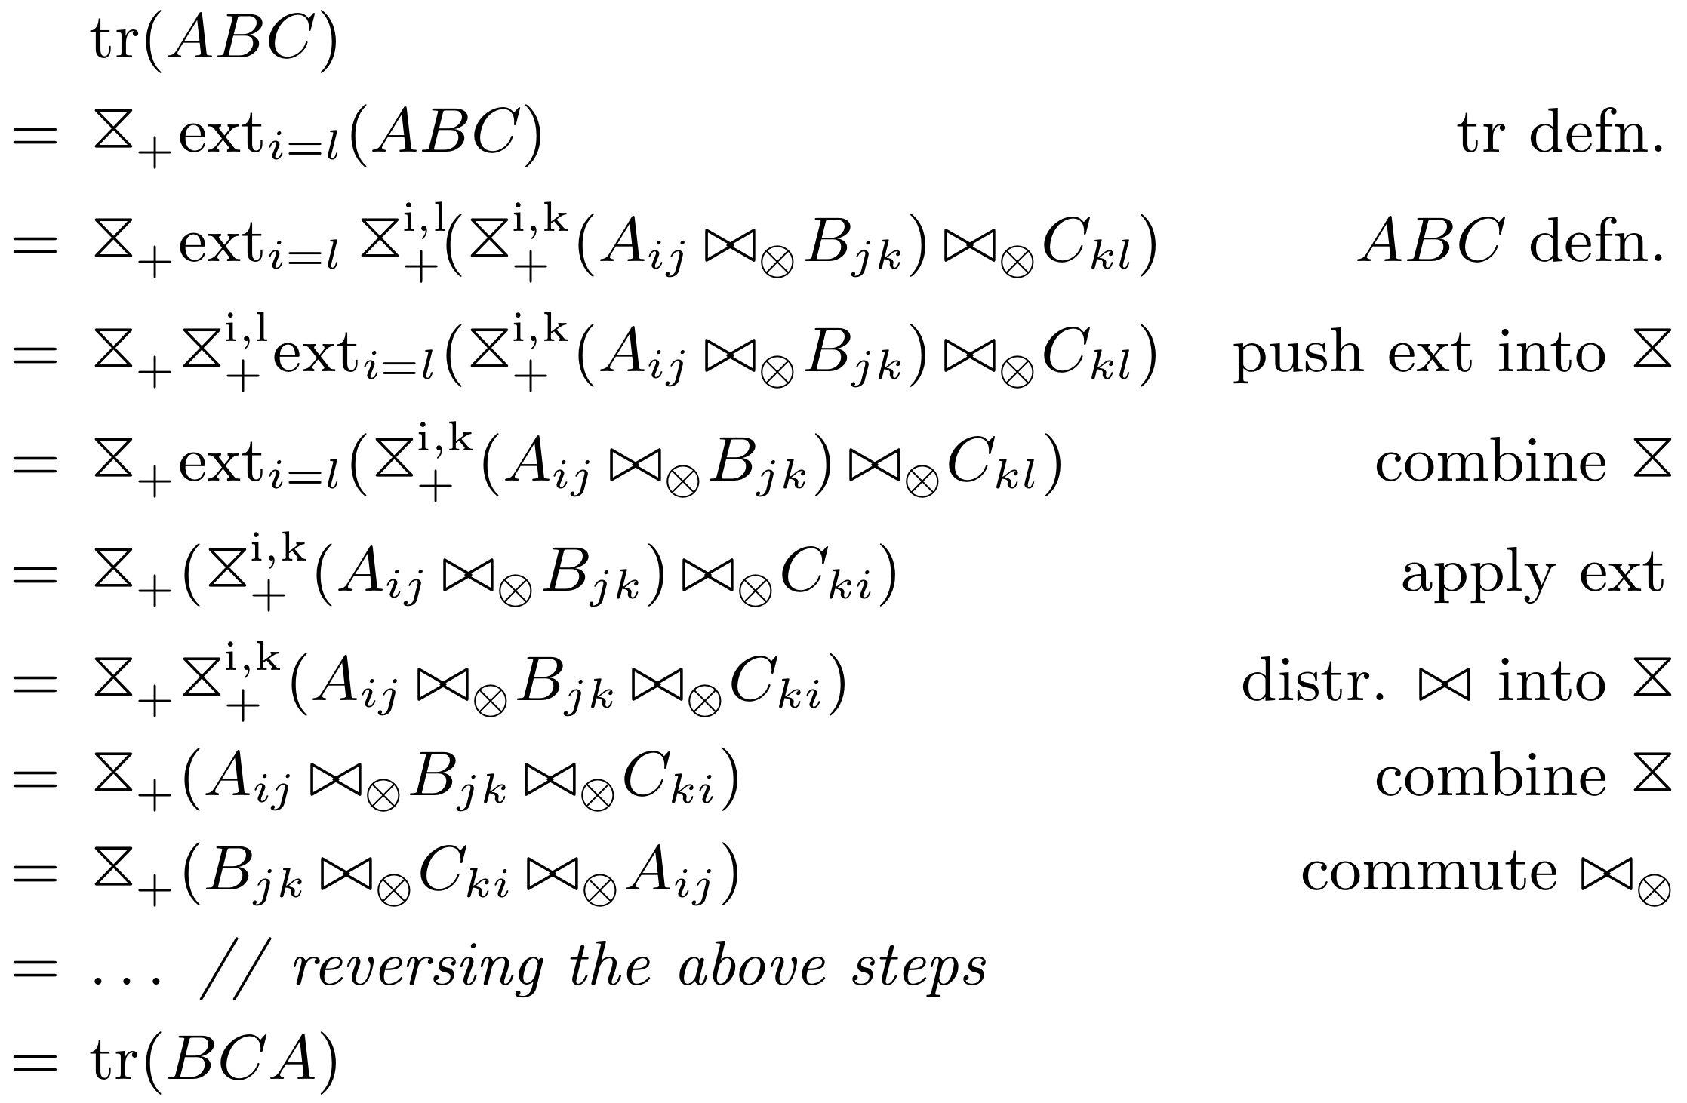
Lara Properties
If ⨁ or ⊗ is associative, commutative, or idempotent,
then so is Union or Join
If ⊗ distributes over ⨁,
Push Union into Join
Distribute Join over Union
See paper for more properties:
Notes:
Now I’ll show just a couple properties that we can prove in the Lara algebra.
These are properties that we can exploit when rewriting Lara plans during query optimization.
First, when + or * have certain properties like ___, then these carry over to their Lara operators union and join.
Second, if * distributes over +, then we push unions operations into join as well as distribute joins over unions.
You’ll have to read the paper to see the details of these statements, but to whet your appetite just a bit more, here is an example of how these properties can be chained together into larger proofs such as this LA statement that the matrix trace operator has a rotation invariance property.
tr(XY) = sum(X ⊗ Y^{T})
tr(ABC) = sum(AB ⊗ C^{T})

Slide 15
Sensor Query:
SQL/MATLAB to Lara
Ext
A, B = load(‘s1.csv’), load(‘s2.csv’)
A' = select bin(t) as t', c, avg(v) as v
from A where 460 <= t <= 860
group by t', c
B' = … // repeat above
// change perspective from RA to LA
X = A - B;
N = size(X, 1);
M = mean(X, 1);
disp(M);
U = X - repmat(M, N, 1);
C = U.' * U ./ (N - 1);
disp(C);
Union
Ext
Filter, bin onto common time buckets
Filter, bin onto common time buckets
Join
Map, Agg
Ext, Union
Subtract
Join
Compute Mean
Compute Covariance
Rename (Ext), Join, Union
Notes:
Coming back to the sensor example, we wrote out SQL and MATLAB that implement the sensor query and translated these to Lara operators.
Please refer to the paper for the details of this translation.
Data conversion as_matrix( ) necessary, to identify rows and columns

Slide 16
LARA
Roadmap
⋈
⊕
⊗
Motivation: Sensor query
Sometimes RA is better, sometimes LA
Lara Algebra
3 Operators & Properties
LaraDB on Sorted Distributed Maps
Physical operators & optimizations
Experiments
Optimizations: Lara affords impactful optimizations
Performance: Lara affords competitive performance
Notes:
Okay, you’ve now seen the logical Lara algebra. The next step is lowering Lara to a physical algebra, so that we can implement it on relevant systems.

Slide 17
Implementing Lara on relevant systems with
Sorted Partitioned Maps
k | v
k₁ | v
k₂ | v
k₃ | v
k₄ | v
k₅ | v
k₆ | v
k₇ | v
An abstraction for:
Relational systems
with primary key
NoSQL key-value systems
Array systems
Map: O(1) access by key
Sorted: O(1) access to “next” element
Partitioned: Scale-out
Partition
Partition
Notes:
We chose the physical data model of sorted partitioned maps.
These are a physical arrangement of key-value data that are (1) indexes by key, (2) sorted by key, and (3) partitioned by key on “split points” so that the data can be processed on multiple machines.
We felt this is a great abstraction to build upon since it covers relational, NoSQL, and array systems.
To see the relational context, notice that almost all relational systems have primary keys that separate attributes into keys and values.

Slide 18
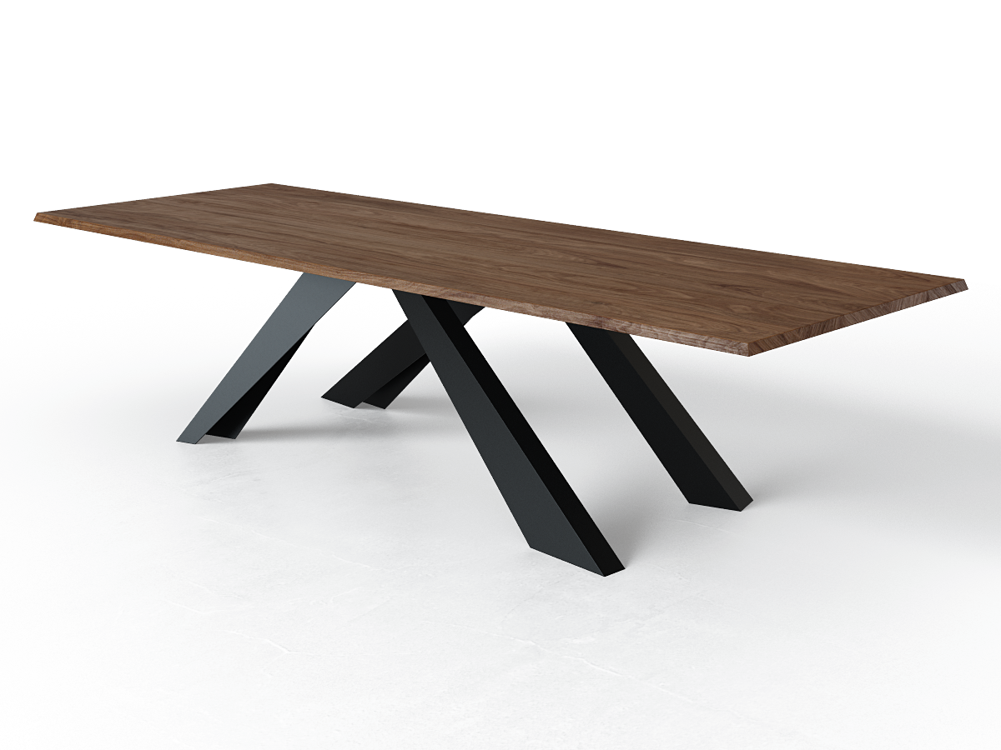

Physical Lara on Sorted Partitioned Maps
Sorted Associative Table:
Ordered key attributes
t | c | [⊥] v
440 | temp | 54.0
440 | hum | 40.8
466 | temp | 55.2
466 | hum | 40.1
492 | temp | 56.3
492 | hum | 35.0
528 | temp | 56.5
[t, c]
Physical Operators:
MergeJoin
MergeUnion
Ext
Sort
(Load)
(Store)
Physical Operators:
MergeJoin
MergeUnion
Ext
Sort
(Load)
(Store)
Partition
Physical
Optimizations
Partition
Accumulo
Row
Column
Qualifier
Value
(BigTable)
LaraDB prototype in Accumulo on Graphulo iterators
Notes:
On this abstraction, here is the physical Lara algebra.
Associative tables are now sorted associative tables, with a sort order placed on the keys.
Join is now MergeJoin, Union is MergeUnion, and Ext remains the same, except that any new keys an ext operator produces append to the sort order.
We’ve also added a Sort operator, which changes the sort order by rewriting a table’s entries. It’s very important to reason about the Sort operator because rewriting a table’s entries is expensive.
Luckily, we’ve found a number of physical optimizations on this physical algebra that do rewrites like eliminating sorts where possible. Please take a look at our paper for more details.
Finally, we implemented this physical algebra on the Accumulo database by mapping keys to Accumulo keys and values to the Accumulo value.
For those of you unfamiliar with Accumulo, Accumulo is a NoSQL, HDFS-backed key-value database that is based on Google BigTable.
In order to do this, we borrowed abstractions for in-database computation in Accumulo from a software library called Graphulo. Altogether, this is LaraDB.

Slide 19
LARA
Roadmap
⋈
⊕
⊗
Motivation: Sensor query
Sometimes RA is better, sometimes LA
Lara Algebra
3 Operators & Properties
LaraDB on Sorted Distributed Maps
Physical operators & optimizations
Experiments
Optimizations: Lara affords impactful optimizations
Performance: Lara affords competitive performance
Notes:
With that, let’s move onto a couple experiments.
The purpose of these experiments are to sanity check Lara – to ensure that when Lara is implemented on a real system, that it can
(A) express optimizations that actually make a difference in performance, and
(B) achieve performance competitive with current systems.

Slide 20
Optimization Experiment
Does Lara afford optimizations that impact performance?
Approach: Benchmark Sensor query on LaraDB. Implement optimizations. Plot runtime reduction.
Cluster: Amazon EC2 m3.large
(2 vCores, 7.5 GB mem, SSD per node)
Notes:
First we test how well Lara can express optimizations that make a practical difference in performance.
We therefore implemented the sensor calculation query and plotted its runtime with different optimizations enabled.

Slide 21
Optimization Experiment
4 Worker nodes
1.5 months’ sensor data
Partitioned in 3 day segments
1.2 GB raw; 60 MB after filter to 1 month, project, compress in HDFS
Notes:
Here we plotted the runtime of the sensor query with no optimizations on the left, each optimization individually in the center, and all the optimizations enabled at once on the right.
I don’t have time to discuss each of these optimizations individually, but for example, the (S) optimization takes advantage of the fact that the inner product is symmetric to only materialize half the entries.
Altogether, these optimizations reduced the sensor query runtime dramatically.
1230 to 72 s
Push sum of partial products into U_20 compaction and flush; assume no repeated writes due to server failure
(D) Defer U_3,C to future scans on U_20, eliminating final pass
(E) Encode numeric attributes in packed byte form
(F) Push filter into Load ‘s1’ from 460 to 860
(M) Eliminate SORT by t’: bin(t) monotone in t
(P) Propagate A, B’s partition splits throughout
(R) Reuse X_0, U_2 data source (common sub-expression)
(S) U^T U is symmetric; only compute upper triangle via Map filter c ≤ c’
(Z) If M, C relaxed to sparse matrix interpretation, identify ⊥ with 0, discarding 0-valued entries, in X 3 and all following tables
The bars measure three portions of the sensor calculation: the filter, bin, and join step at the bottom; subtracting the measurement class mean from each entry in the middle, and the inner product matrix multiply at the top. We see that the MxM dominates runtime. We also see that different optimizations impacted different parts of the computation, and that the net effect of all the optimizations reduced runtime from

Slide 22
Performance Experiment
Does Lara afford competitive performance when implemented?
Approach: Benchmark Matrix Multiply on data in Accumulo
Engines: LaraDB and Hadoop MapReduce
Task: Matrix-Matrix Multiply (Graph500 power law matrices)
MxM is a building block of both LA and RA (join, aggregate)
Cluster: Amazon EC2 m3.large
(2 vCores, 7.5 GB mem, SSD per node)
Notes:
Now we test how well Lara admits performance.
The task we chose is matrix multiply on power law matrices stored in Accumulo. We chose this task because LaraDB is implemented in Accumulo, and matrix multiply is a kind of analytic people perform on data in Accumulo as well as a foundational operator for both LA and RA.
The engine we compare against is Hadoop MapReduce. Admittedly, Spark is a more modern engine we could have compared against, but we chose MapReduce because it has a native integration with Accumulo that is recommended by the Accumulo community.
(outer product form)

Slide 23
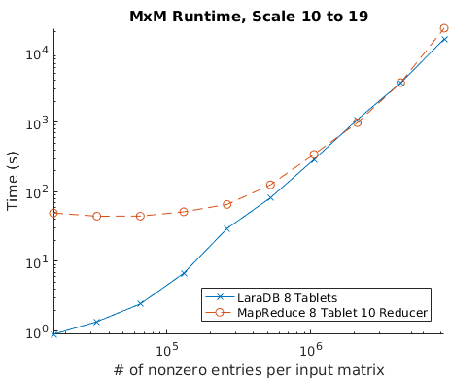
Performance Experiment
Convergence
at larger inputs
Huge YARN
startup cost
8 Worker nodes
16 × 2^{SCALE} entries, generated from Graph500, partitioned evenly on input rows
Scale 19 MxM forms 8 × 10⁹ partial products, skewed due to power law
Notes:
X-axis: size of each input matrix.
Y-axis: run time. Lower is better.
We see that LaraDB performs much better on smaller data sizes because it runs within the Accumulo database, which has a thread pool ready to start servicing requests immediately.
On the other hand, MapReduce has a cold start, since it must wait for the YARN resource manager to allocate containers on all the machines and copy JARs to those containers.
This is exactly what we expect. LaraDB and MapReduce both run the same algorithm, implemented with similar code, using the same parallelism and the same data partitioning on the same cluster.
It therefore shows that when we run matrix multiply from the Lara abstraction, we can obtain competitive performance.
2³³ (= 8 × 10⁹) partial products at scale 19

Slide 24



LARA
Recap
⋈
⊕
⊗
Motivation: Sensor query
Sometimes RA is better, sometimes LA
Lara Algebra
3 Operators & Properties
LaraDB on Sorted Distributed Maps
Physical operators & optimizations
Experiments
Optimizations: Lara affords impactful optimizations
Performance: Lara affords competitive performance
Join
Union
⋈⊗
⋈
⨁
Extension
ext_{f}
Additional thanks to David Maier, Tim Mattson, Jeremy Kepner, Vijay Gadepally

Slide 25
Backup Slides

Slide 26
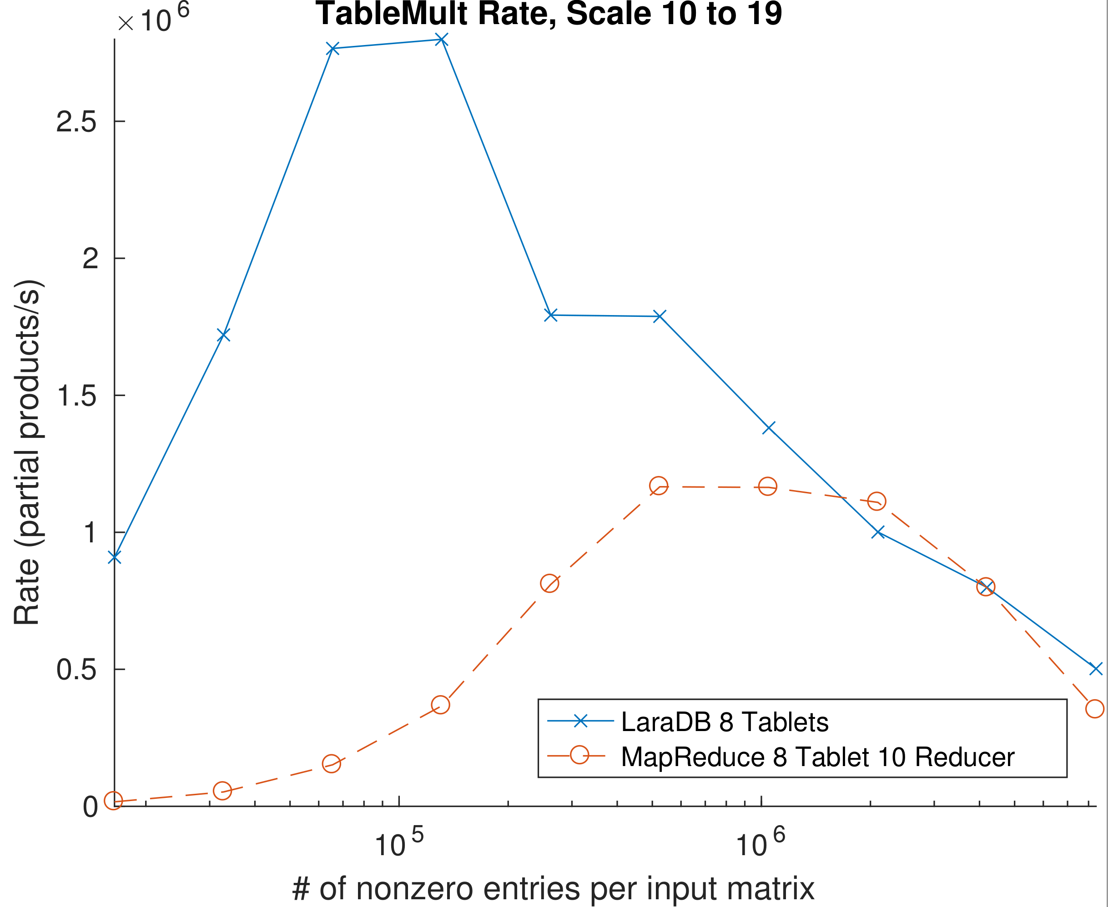
Competitiveness Experiment
Convergence
at larger inputs
Sustained Ingest:
compactions throttle Accumulo
Burst
Ingest
Huge YARN
startup cost
8 Worker nodes
16 × 2^{SCALE} entries, generated from Graph500, partitioned evenly on input rows
Scale 19 MxM forms 8 × 10⁹ partial products, skewed due to power law
Notes:
2³³ (= 8 × 10⁹) partial products at scale 19
Cold vs. warm start
similar code, similar parallelism, same data partitioning
To give you a bit more insight into what is happening in Accumulo, here is the rate plot, in terms of partial products per second

Slide 27
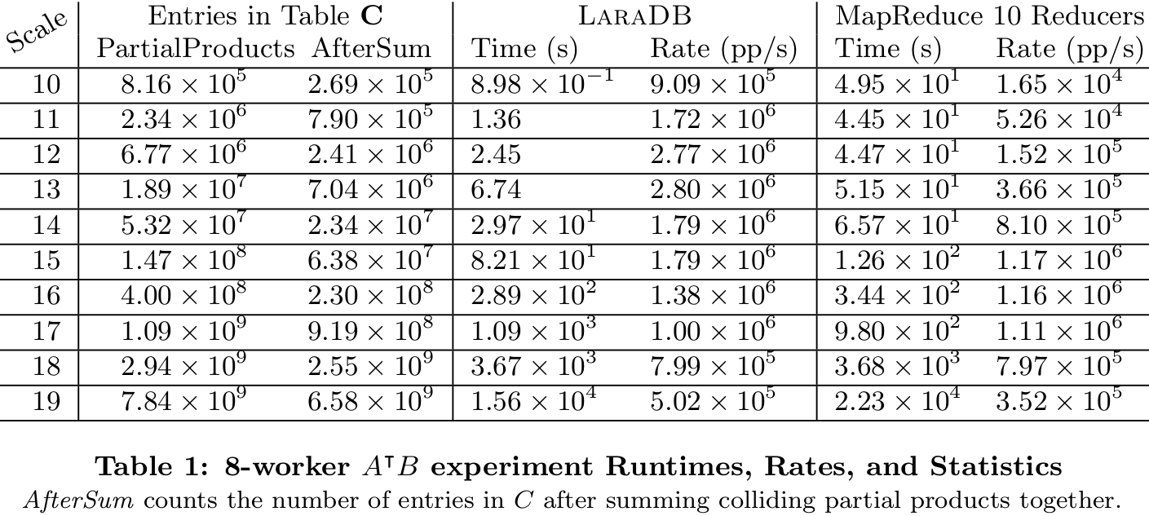
Data for Competitiveness Experiment

Slide 28
Expressiveness Experiment
4 Worker nodes
1.5 months’ sensor data
Partitioned in 3 day segments
1.2 GB raw; 60 MB after filter to 1 month, project, compress in HDFS
Notes:
1230 to 72 s
Push sum of partial products into U_20 compaction and flush; assume no repeated writes due to server failure
(D) Defer U_3,C to future scans on U_20, eliminating final pass
(E) Encode numeric attributes in packed byte form
(F) Push filter into Load ‘s1’ from 460 to 860
(M) Eliminate SORT by t’: bin(t) monotone in t
(P) Propagate A, B’s partition splits throughout
(R) Reuse X_0, U_2 data source (common sub-expression)
(S) U^T U is symmetric; only compute upper triangle via Map filter c ≤ c’
(Z) If M,C relaxed to sparse matrix interpretation, identify ⊥ with 0, discarding 0-valued entries, in X 3 and all following tables

Slide 29
Expressiveness Experiment
4 Worker nodes
1.5 months’ sensor data
Partitioned in 3 day segments
1.2 GB raw; 60 MB after filter to 1 month, project, compress in HDFS
Notes:
1230 to 72 s
Push sum of partial products into U_20 compaction and flush; assume no repeated writes due to server failure
(D) Defer U_3,C to future scans on U_20, eliminating final pass
(E) Encode numeric attributes in packed byte form
(F) Push filter into Load ‘s1’ from 460 to 860
(M) Eliminate SORT by t’: bin(t) monotone in t
(P) Propagate A, B’s partition splits throughout
(R) Reuse X_0, U_2 data source (common sub-expression)
(S) U^T U is symmetric; only compute upper triangle via Map filter c ≤ c’
(Z) If M,C relaxed to sparse matrix interpretation, identify ⊥ with 0, discarding 0-valued entries, in X 3 and all following tables

Slide 30
Expressiveness Experiment
4 Worker nodes
1.5 months’ sensor data
Partitioned in 3 day segments
1.2 GB raw; 60 MB after filter to 1 month, project, compress in HDFS
Notes:
1230 to 72 s
Push sum of partial products into U_20 compaction and flush; assume no repeated writes due to server failure
(D) Defer U_3,C to future scans on U_20, eliminating final pass
(E) Encode numeric attributes in packed byte form
(F) Push filter into Load ‘s1’ from 460 to 860
(M) Eliminate SORT by t’: bin(t) monotone in t
(P) Propagate A, B’s partition splits throughout
(R) Reuse X_0, U_2 data source (common sub-expression)
(S) U^T U is symmetric; only compute upper triangle via Map filter c ≤ c’
(Z) If M,C relaxed to sparse matrix interpretation, identify ⊥ with 0, discarding 0-valued entries, in X 3 and all following tables

Slide 31
Expressiveness Experiment
3 Parts of Sensor Calc
Matrix multiply & divide
Subtract mean
Filter, bin, join sensors
4 Worker nodes
1.5 months’ sensor data
Partitioned in 3 day segments
1.2 GB raw; 60 MB after filter to 1 month, project, compress in HDFS
Notes:
Here we plotted the runtime of the sensor query with no optimizations on the left, each optimization individually in the center, and all the optimizations enabled at once on the right.
The bars measure three portions of the sensor calculation: the filter, bin, and join step at the bottom; subtracting the measurement class mean from each entry in the middle, and the inner product matrix multiply at the top. We see that the MxM dominates runtime. We also see that different optimizations impacted different parts of the computation, and that the net effect of all the optimizations reduced runtime from
1230 to 72 s
Push sum of partial products into U_20 compaction and flush; assume no repeated writes due to server failure
(D) Defer U_3,C to future scans on U_20, eliminating final pass
(E) Encode numeric attributes in packed byte form
(F) Push filter into Load ‘s1’ from 460 to 860
(M) Eliminate SORT by t’: bin(t) monotone in t
(P) Propagate A, B’s partition splits throughout
(R) Reuse X_0, U_2 data source (common sub-expression)
(S) U^T U is symmetric; only compute upper triangle via Map filter c ≤ c’
(Z) If M,C relaxed to sparse matrix interpretation, identify ⊥ with 0, discarding 0-valued entries, in X 3 and all following tables

Slide 32
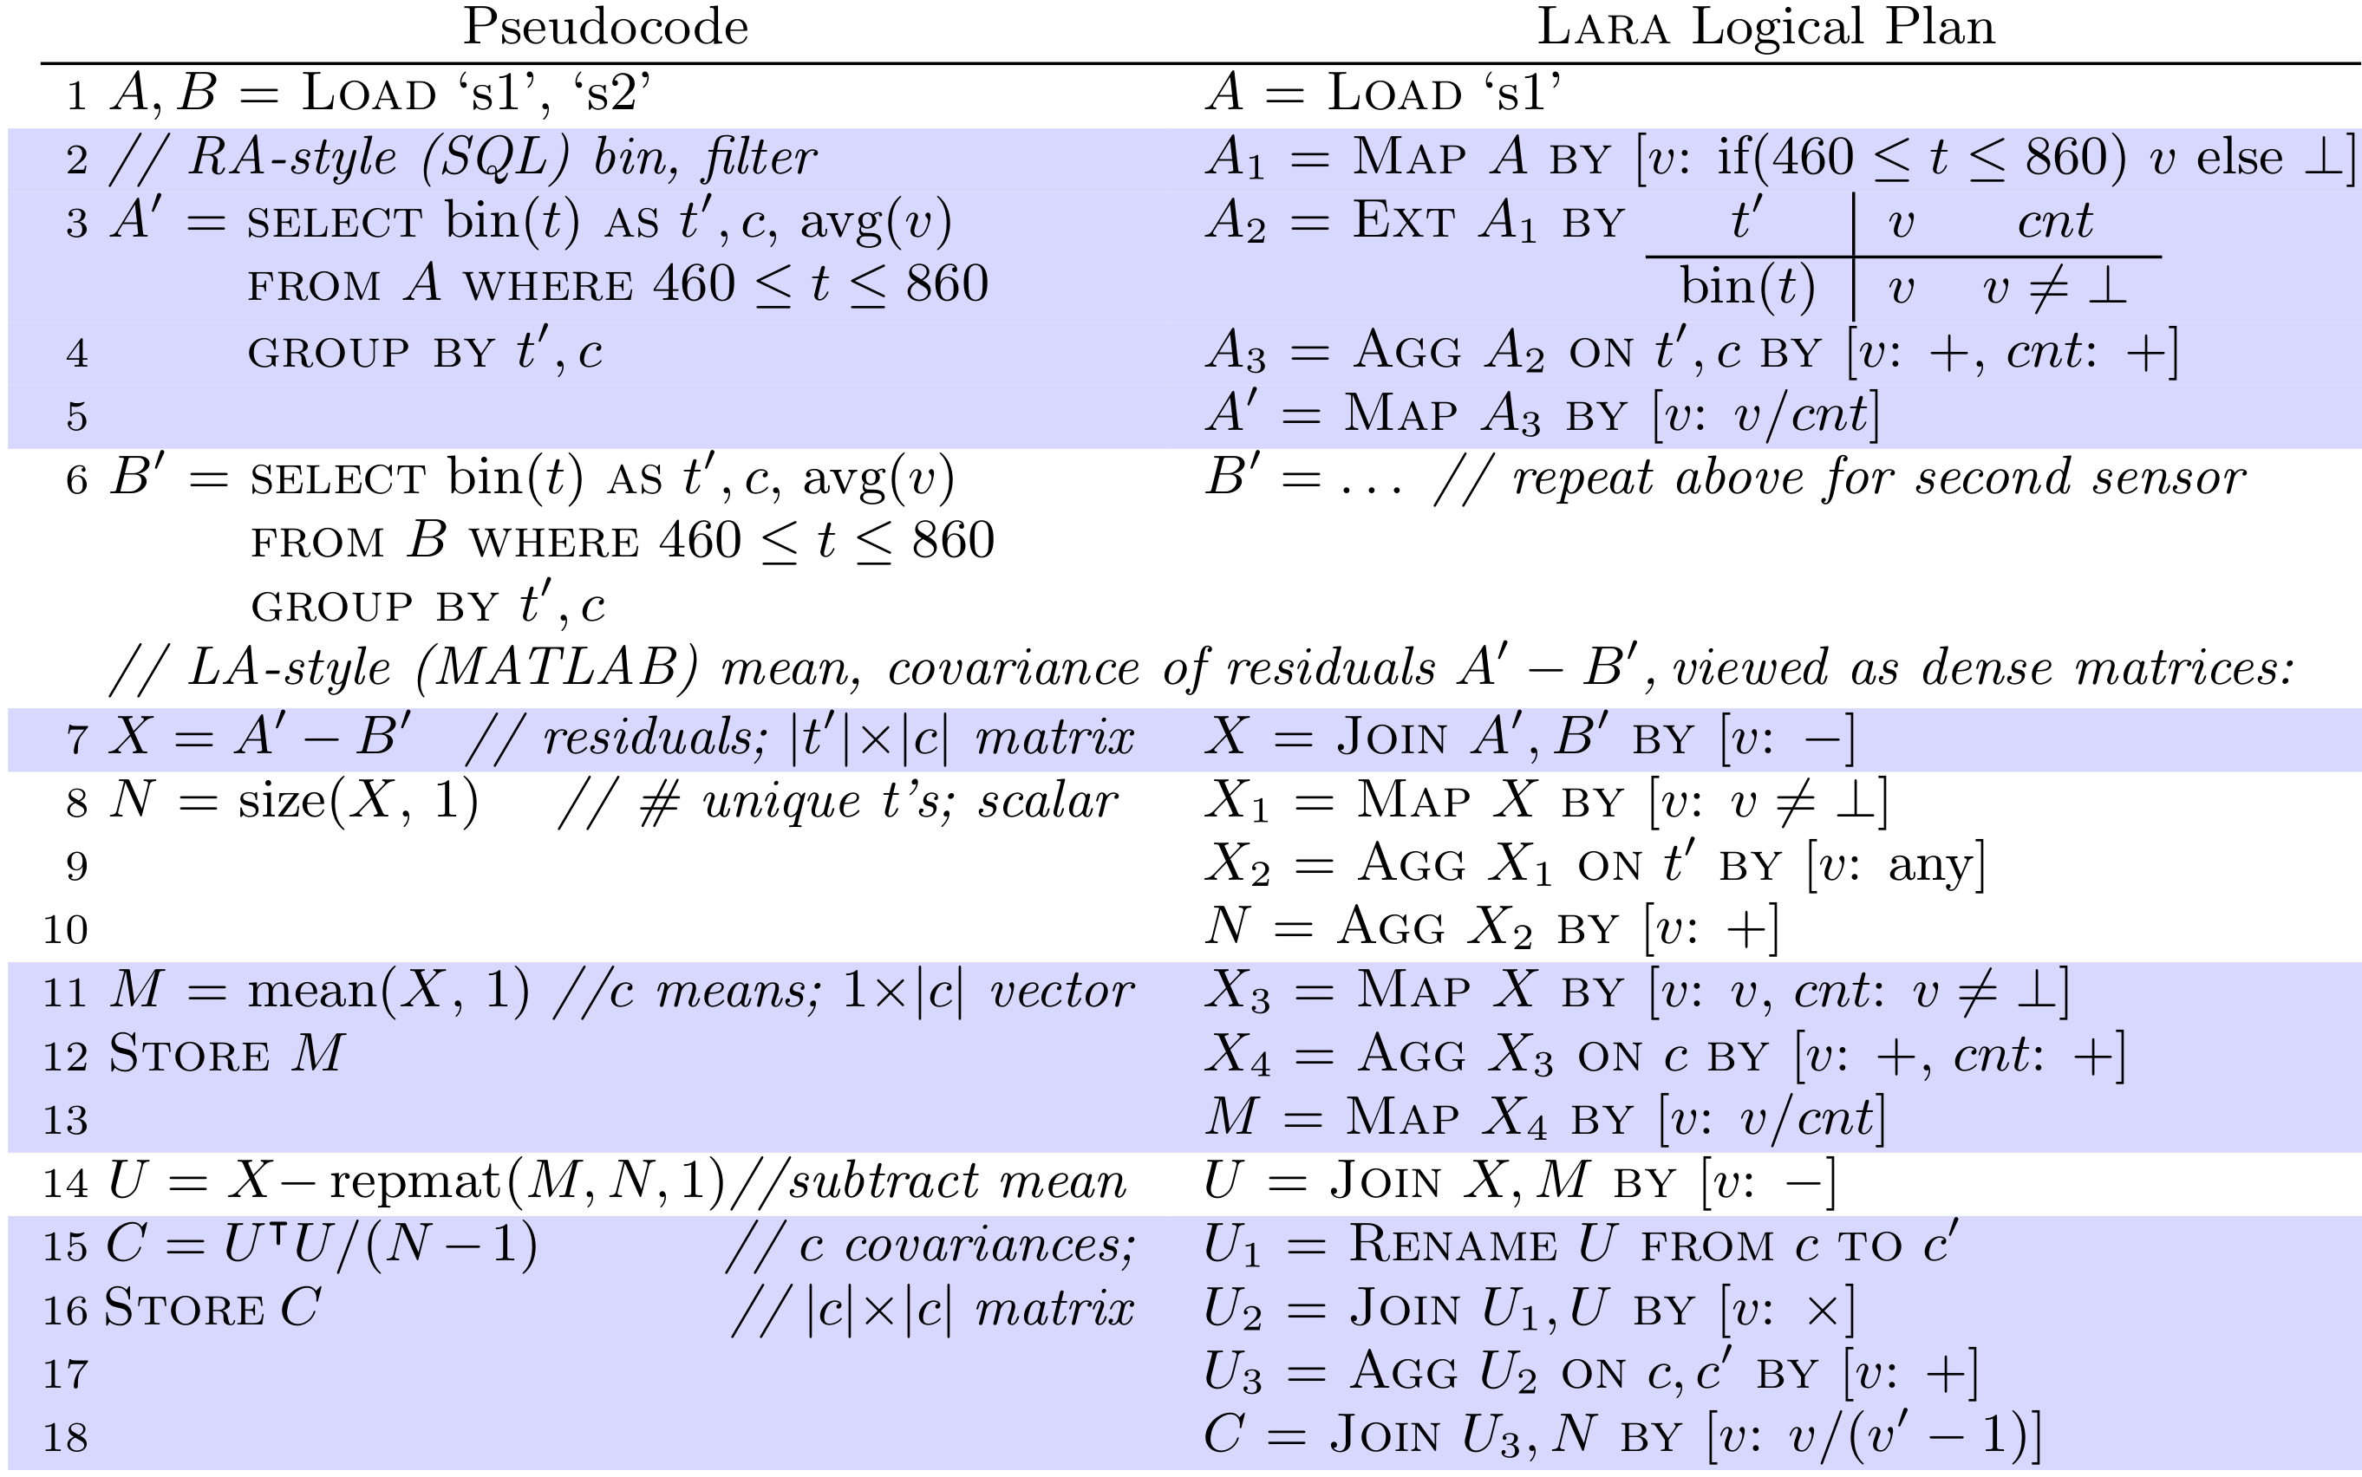
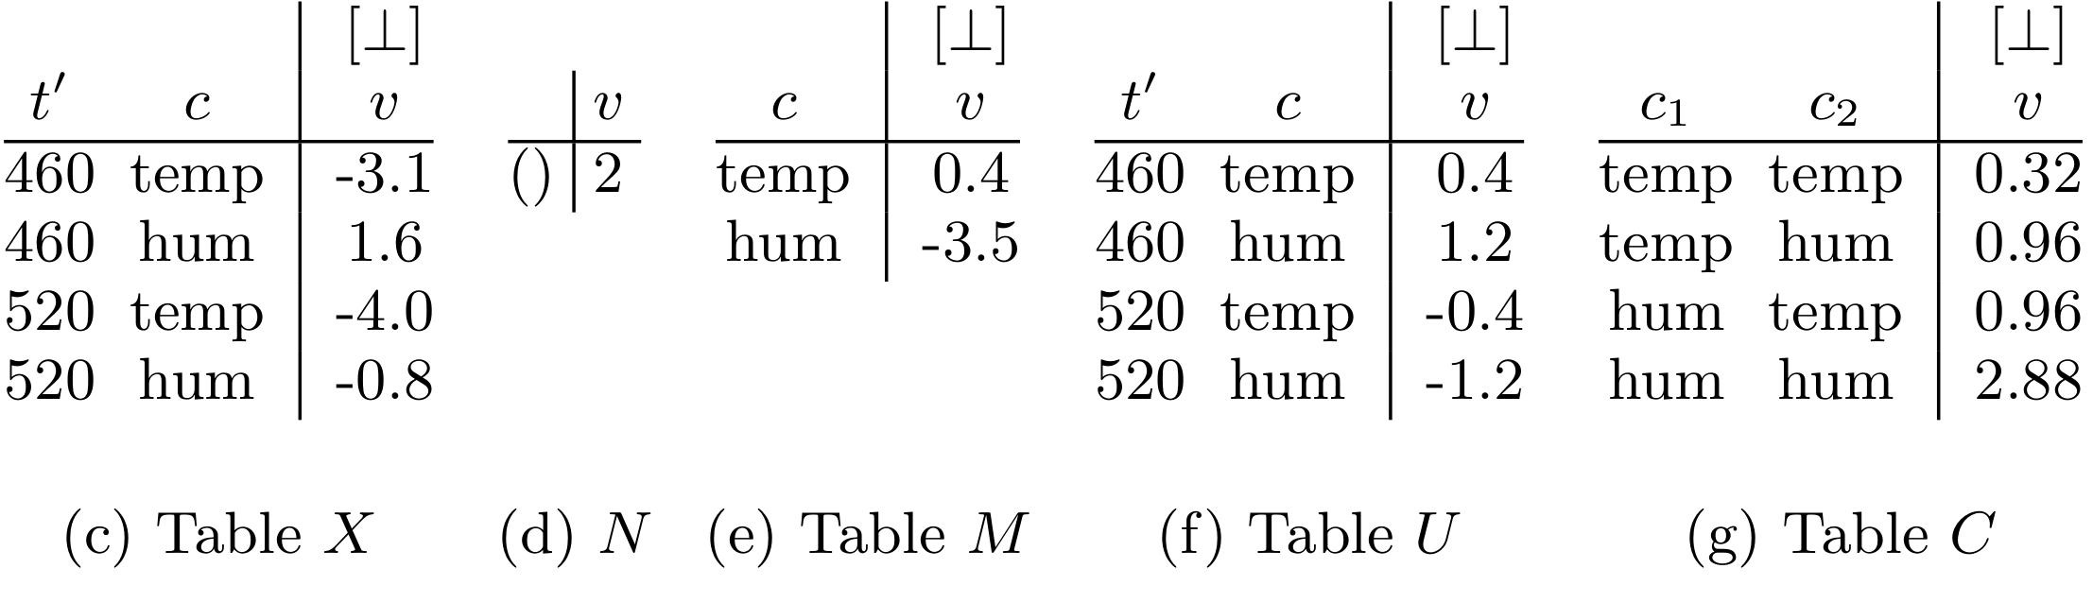
Sensor Query, complete translation to Lara
Sensor Query, complete translation to Lara

Slide 33
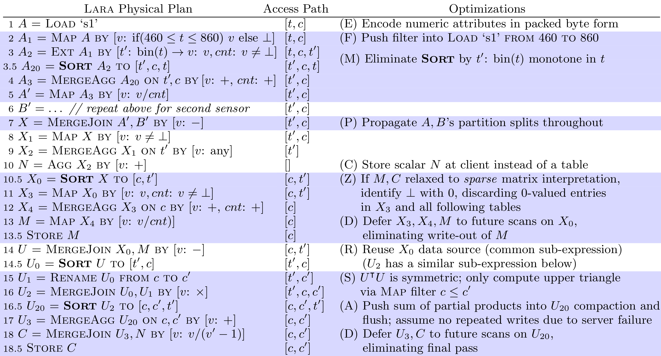
Sensor Query, Physical Lara and Optimizations
Example optimization:
Eliminate Sort after monotonic Ext
Notes:
When we have an Ext that produces keys that are monotonic in the input keys, then we can move the new keys first in the sort order without having to ReSort the data.
If we do a Map and then discard zeros, and it holds that the Map is stationary on ⊥ and 0, then we can safely discard zeros before the map

Slide 34
t | c | t' | [⊥] v | [0] cnt
466 | temp | 460 | 55.2 | 1
466 | hum | 460 | 40.1 | 1
492 | temp | 520 | 56.3 | 1
492 | hum | 520 | 35.0 | 1
528 | temp | 520 | 56.5 | 1
LARA
DB
⋈
⊕
⊗
Join
Union
Extension
⋈⊗
⋈
ext_{f}
⨁
Contact: dhutchis@cs.washington.edu

Slide 35
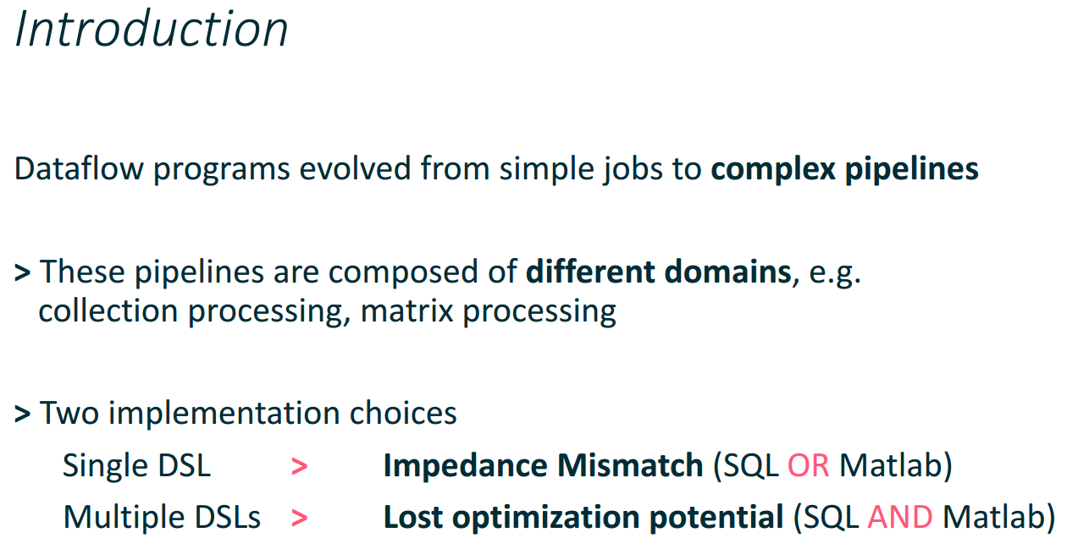
slide from Andreas Kunft, Alexander Alexandrov, Asterios Katsifodimos, Volker Markl’s
2016 BeyondMR talk: Towards optimization across linear and relational algebra
Relational Algebra (RA): Preprocessing
Linear Algebra (LA): Analytics
Some tasks and properties easier to express in RA, others in LA
Using both RA and LA is difficult without a means of translation, such as a common algebra
Notes:
I’d like to open with a slide from last year’s BeyondMR talk by Andreas and others from TU Berlin, who envisioned a language that unified LA and RA, at about the same time that we posted our first Lara technical report.
We know that government, science, and enterprise domains increasingly cross multiple data models.
Two of the most common of these are RA and LA.
Stuff all their computation into one data model, which faces impedance mismatch problems. We know this is a problem because, later, we’ll see examples of tasks and properties easy to express in LA but not RA and vice versa.
OR use both LA and RA, but this is difficult without a means of translating one into the other, such as a common algebra.
(polystore)
As Andreas observed last year, users in these domains often face a difficult decision:
To write their code entirely in an RA data model or an LA data model, in which case they face the impedance mismatch barrier of fitting LA computation into an RA data model and RA computation into an LA data model, OR
To write their code in both RA and LA data models, in which case they face challenges at the systems level and the optimizer level.
To this I add a couple observations:
We know that both the impedance mismatch and optimization barriers are real because there are, in fact, tasks and properties that are simple to express in one but not the other. I will show you examples of this momentarily.
If we could develop a common algebra spanning RA and LA, then we would eliminate all these barriers, gaining the ability to use and optimize across RA and LA.

Slide 36
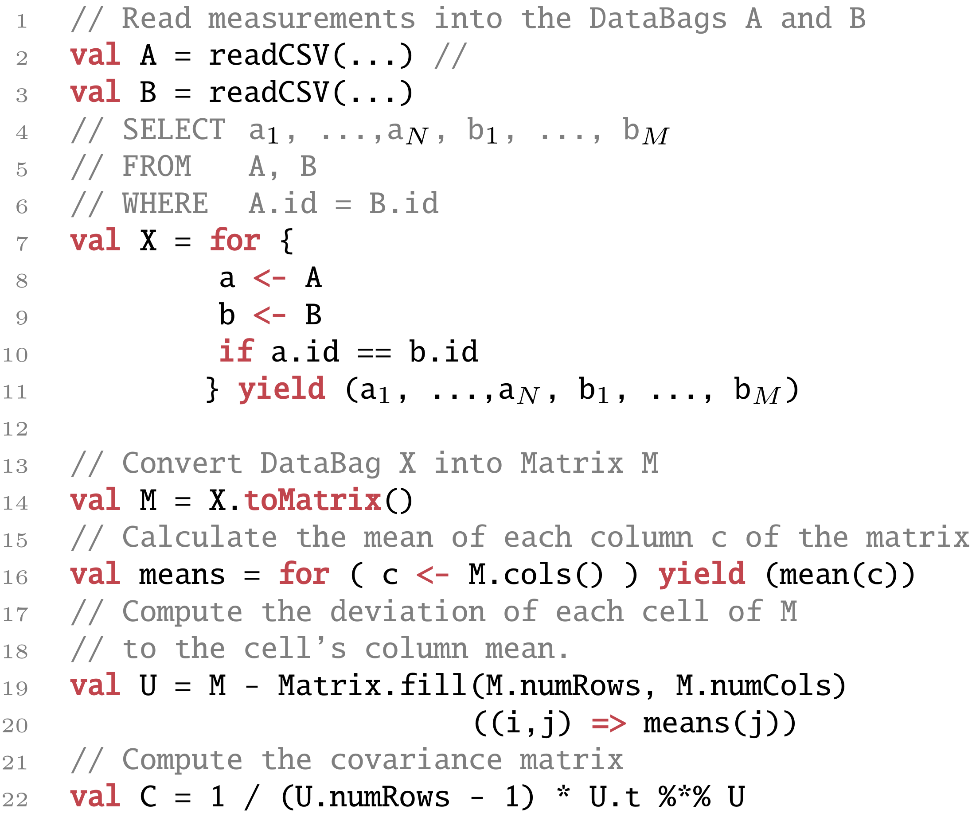
Last year’s Sensor example: Combine measurements, compute means & covariances
Preprocessing
(easier to express in RA)
Analysis
(easier to express in LA)
Notes:
Also as part of last year’s talk, Andreas et al introduced a hypothetical sensor processing example, which has a clear preprocessing phase that is easier to express in RA and an analysis phase that is easier to express in LA.

Slide 37
Use Lara underneath Weld?
Weld replaced the implementation of Pandas (RAish) and NumPy (Laish)
Weld chose a MapReduce algebra
Would Weld benefit from using Lara algebra instead?
S. Palkar, J. J. Thomas, A. Shanbhag, D. Narayanan, H. Pirk, M. Schwarzkopf, S. Amarasinghe, M. Zaharia, and S. InfoLab. Weld: A common runtime for high performance data analytics. CIDR, Jan. 2017.

Slide 38
Sensor Query, Alternate Plan
A, B = load(‘s1.csv’), load(‘s2.csv’)
A' = select bin(t) as t', c, avg(v) as v
from A where 460 <= t <= 860
group by t', c
B' = … // repeat above
X = A - B;
N = size(X, 1);
M = mean(X, 1);
disp(M);
U = X - repmat(M, N, 1);
C = U.' * U ./ (N - 1);
disp(C);
A, B = load(‘s1.csv’), load(‘s2.csv’)
A' = select bin(t) as t', c, avg(v) as v
from A where 460 <= t <= 860
group by t', c
B' = … // repeat above
X = A - B;
N = size(X, 1);
M = mean(X, 1);
disp(M);
C = N ./ (N – 1) .* ((X.' * X ./ N) – M.' * M);
disp(C);

Slide 39
Filter as Lara Map (Ext)
t | c | [⊥] v
440 | temp | 54.0
440 | hum | 40.8
466 | temp | 55.2
466 | hum | 40.1
492 | temp | 56.3
492 | hum | 35.0
528 | temp | 56.5
t | c | [⊥] v
440 | temp | ⊥
440 | hum | ⊥
466 | temp | 55.2
466 | hum | 40.1
492 | temp | 56.3
492 | hum | 35.0
528 | temp | 56.5
A' = select t, c, v from A
where 460 <= t <= 860
A₁ = Map A by
[v: if (460 ≤ t ≤ 860) v else ⊥]
() | [⊥] v
() | if (460 ≤ t ≤ 860) v else ⊥
UDF f as a table-valued function, ready for ext (flatmap)

Slide 40
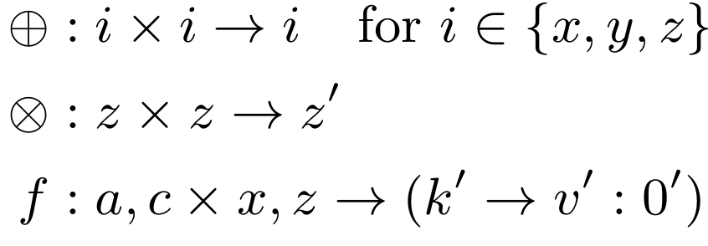
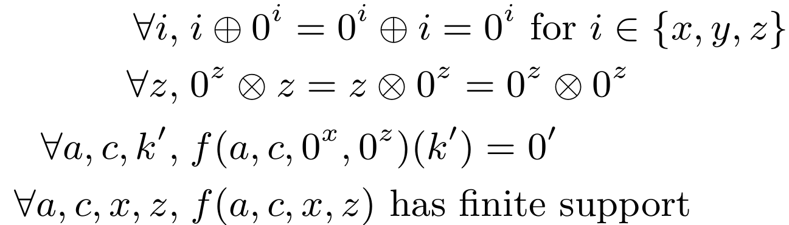
Lara on One Slide
f(a, c, x, z) =
UDFs:
UDF Requirements:
k' | [0'] v'
A
B
a | c | [0^{x}] x | [0^{z}] z
c | b | [0^{z}'] z | [0^{y}] y
Join A, B by ⊗
a | c | b | [0^{z} ⊗ 0^{z}'] z
Union A, B by ⨁
c | [0^{x}] x | [0^{z} (= 0^{z}')] z | [0^{y}] y
Ext A by f
a | c | k' | [0'] v'

Slide 41
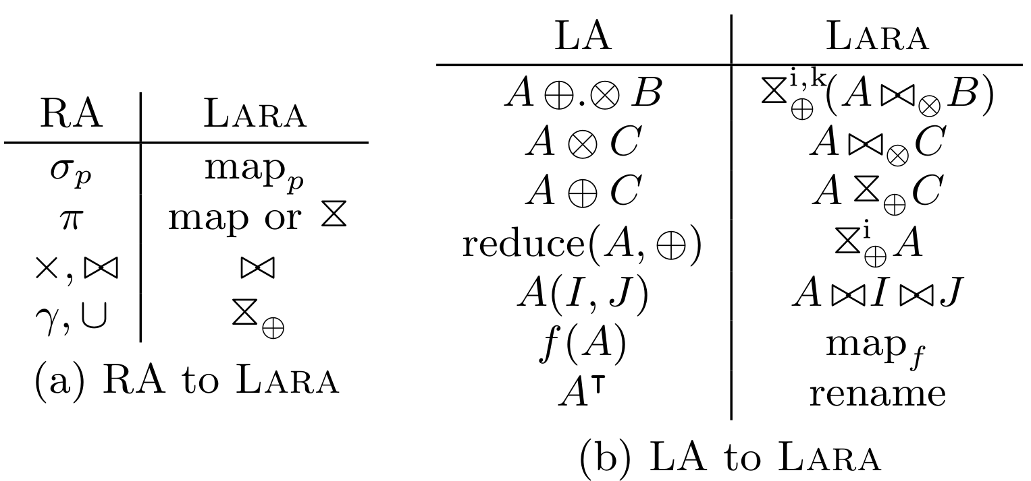
Translating LA and RA to Lara
Given
GraphBLAS
Roughly: LA, RA ⊆ Lara ⊆ MapReduce
Notes:
Flatmap: tokenize (RA), explode (LA)
⊆ λ-Calculus

Slide 42
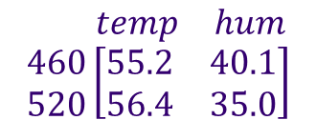
Convert RA Relation, LA Matrix
to Lara Associative Table
Identify keys; separate attributes into keys and values
Introduce sparsity; make the table a total function: keys → values with finite support
t' | c | v
460 | temp | 55.2
460 | hum | 40.1
520 | temp | 56.4
520 | hum | 35.0
t' | c | v
460 | temp | 55.2
460 | hum | 40.1
520 | temp | 56.4
520 | hum | 35.0
$$\begin{matrix} & temp & hum\end{matrix} \\ \begin{matrix}460 \\ 520\end{matrix}\left[\begin{matrix}55.2 & 40.1 \\ 56\text{.}4 & 35.0\end{matrix}\right]$$

Slide 43
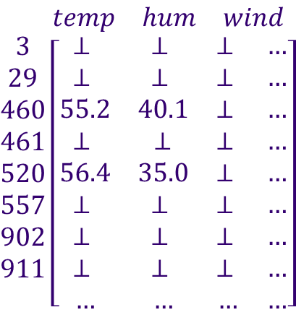
Convert RA Relation, LA Matrix
to Lara Associative Table
Identify keys; separate attributes into keys and values
Introduce sparsity; make the table a total function: keys → values with finite support
Set of keys that map to non-default values
Default value
t' | c | [⊥] v
460 | temp | 55.2
460 | hum | 40.1
520 | temp | 56.4
520 | hum | 35.0
(3 | wind | ⊥)
(461 | temp | ⊥)
(… | … | …)
t' | c | v
460 | temp | 55.2
460 | hum | 40.1
520 | temp | 56.4
520 | hum | 35.0
461 | temp | ⊥
461 | wind | ⊥
902 | hum | ⊥
3 | wind | ⊥
95 | hum | ⊥
$$\begin{matrix} & temp & hum & wind\end{matrix} \\ \begin{matrix}3 \\ 29 \\ 460 \\ 461 \\ 520 \\ 557 \\ 902 \\ 911 \\ \end{matrix}\left[\begin{matrix}\text{⊥ } & \text{⊥ } & \text{⊥ } & … \\ \text{⊥ } & \text{⊥ } & \text{⊥ } & … \\ 55.2 & 40.1 & \text{⊥ } & … \\ \text{⊥} & \text{⊥} & \text{⊥} & … \\ 56\text{.}4 & 35.0 & \text{⊥ } & … \\ \text{⊥ } & \text{⊥ } & \text{⊥ } & … \\ \text{⊥ } & \text{⊥ } & \text{⊥ } & … \\ \text{⊥ } & \text{⊥ } & \text{⊥ } & … \\ … & … & … & …\end{matrix}\right]$$
Support

Slide 44
Filter as Lara Map (Ext)
t | c | [⊥] v
440 | temp | 54.0
440 | hum | 40.8
466 | temp | 55.2
466 | hum | 40.1
492 | temp | 56.3
492 | hum | 35.0
528 | temp | 56.5
t | c | [⊥] v
440 | temp | ⊥
440 | hum | ⊥
466 | temp | 55.2
466 | hum | 40.1
492 | temp | 56.3
492 | hum | 35.0
528 | temp | 56.5
A' = select t, c, v from A
where 460 <= t <= 860
A₁ = Map A by
[v: if (460 ≤ t ≤ 860) v else ⊥]

Slide 45
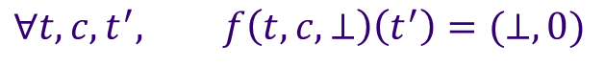
Bin as Lara Ext
t | c | [⊥] v
466 | temp | 55.2
466 | hum | 40.1
492 | temp | 56.3
492 | hum | 35.0
528 | temp | 56.5
t | c | t' | [⊥] v | [0] cnt
466 | temp | 460 | 55.2 | 1
466 | hum | 460 | 40.1 | 1
492 | temp | 520 | 56.3 | 1
492 | hum | 520 | 35.0 | 1
528 | temp | 520 | 56.5 | 1
A₂ = select t, bin(t) as t', c,
v, v ≠ ⊥ as cnt from A₁
A₂ = Ext A₁ by
t' | [⊥] v | [0] cnt
bin(t) | v | 1, v ≠ ⊥ 0, v = ⊥
f(t, c, v) =
Appends new key t', replaces values
Ext function f maintains finite support because
$$∀t,c,t^{′}, f\left(t,c,⊥\right)\left(t^{′}\right)=(⊥, 0)$$
Notes:
RA Select, LA Matrix Subref

Slide 46
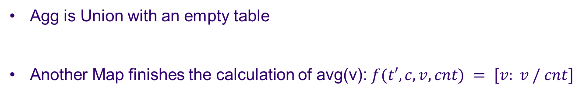
Avg as Lara Agg (Union)
t | c | t' | [⊥] v | [0] cnt
466 | temp | 460 | 55.2 | 1
466 | hum | 460 | 40.1 | 1
492 | temp | 520 | 56.3 | 1
492 | hum | 520 | 35.0 | 1
528 | temp | 520 | 56.5 | 1
t' | c | [⊥] v | [0] cnt
460 | temp | 55.2 | 1
460 | hum | 40.1 | 1
520 | temp | 112.8 | 2
520 | hum | 35.0 | 1
A₃ = select t', c, sum(v) as v,
sum(cnt) as cnt from A₂
A₃ = Agg A₂ on t', c
by [v: +, cnt: +]
t' | c | ()
Agg is Union with an empty table
Another Map finishes the calculation of avg(v): $f(t′, c, v, cnt) = [v: v / cnt]$
Notes:
RA Select, LA Matrix Subref

Slide 47
Subtract as Lara Join
t' | c | [⊥] v
460 | temp | 55.2
460 | hum | 40.1
520 | temp | 56.4
520 | hum | 35.0
t' | c | [⊥] v
460 | temp | 58.3
460 | hum | 38.5
520 | temp | 60.4
t' | c | [⊥] v
460 | temp | -3.1
460 | hum | 1.6
520 | temp | -4.0
⋈–
=
X = A – B
X = Join A, B by [v: –]
Let Ɐa, ⊥ – a = a – ⊥ = ⊥

Slide 48
Last year Andreas observed that computational pipelines increasingly cross data models, in particular RA and LA. He illustrated why this is a problem with a sensor example.
We found data that made the sensor example real, from a project called the Array of Things started right here in the city of Chicago.
Added a few more preprocessing tasks (filtering, binning) to fit the real data.
Why is a common algebra possible?
Lara; discuss associative table on the spot
Join, Union, (Join-Union duality), Ext, properties
Sensor example pseudocode, logical Lara
Sorted Distributed Maps – relational, key-value, array systems
Lower to Physical algebra, Accumulo
Admits lots of optimizations; these significantly reduced runtime
Does performance take a nosedive if we use Lara as a guiding abstraction for implementations? No; competitiveness experiment with MapReduce, analytics engine natively integrated with Accumulo on MxM, a fundamental building block for LA and RA

Slide 49
Ext: Flatmap
a | c | k' | [0 – 0 = 0] v'
a₁ | c₁ | a₁c₁ | 11 – 5
a₁ | c₁ | c₁a₁ | 5 – 11
a₁ | c₂ | a₁c₂ | 12 – 2
a₁ | c₂ | c₂a₁ | 2 – 12
a₂ | c₁ | a₂c₁ | 13 – 3
a₂ | c₁ | c₁a₂ | 3 – 13
a | c | [0] x | [0] z
a₁ | c₁ | 11 | 1
a₁ | c₂ | 12 | 2
a₂ | c₁ | 13 | 3
ext_{f}
=
f(a, c, x, z) =
k' | v'
ac | x – z
ca | z – x
Requires:
Notes:
Run f on each row independently, replaces values
Appends new keys (never deletes)
Monotonic in key type; no collisions
No free variables
Use Join/Union to interface with external tables
Requirement for finite support:
Map: special case when k' = ()
Rename: map that changes attribute names
RA: CROSS APPLY
LA: EXPLODE

Slide 50
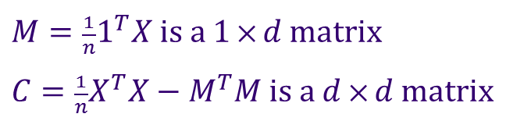
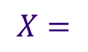
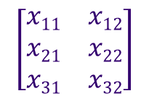
Covariance query: easy in LA, harder in RA
d attributes
$M=\frac{1}{n}1^{T}X$ is a 1 $⨉ d$ matrix $C=\frac{1}{n}X^{T}X−M^{T}M$ is a $d$ $⨉ d$ matrix
$$X=$$
$$\left[\begin{matrix}x11 & x12 \\ x21 & x22 \\ x31 & x32\end{matrix}\right]$$
n points
LA
N = size(X, 1);
M = mean(X, 1);
C = X'*X / N – M'*M;
RA
(Generated SQL statements for each entry)
T = select from X sum(1.0) as N,
sum(X₁) as M₁, sum(X₂) as M₂, …, sum(X_{d}) as M_{d},
sum(X₁*X₁) as Q₁₁, sum(X₁*X₂) as Q₁₂, …,
sum(X_{d-1}*X_{d}) as Q_{(d-1)d}, sum(X_{d}*X_{d}) as Q_{dd}
C = select from T
(1 as i, 1 as j, Q₁₁/N – M₁*M₁ as v) union
(1 as i, 2 as j, Q₁₂/N – M₁*M₂ as v) union
…
Carlos Ordonez.
Building Statistical Models and Scoring with UDFs. SIGMOD 2007.
Notes:
Here is a covariance query on a data matrix with n d-dimensional points. The LA math equations for covariance are simple, and platforms like MATLAB realize them directly.
If we wanted to realize a covariance calculation in SQL instead, we would need to use techniques from a series of SIGMOD papers that generate large SQL queries like this.
Clearly the LA approach is the way to go.
This approach stores each column of the matrix X as a separate attribute.
Another approach is (I, j, v). We could use Lara to write the equations for this.
To prove that the MATLAB implements the LA, use: 1/n * (X – 1M)^{T}(X – 1M) = 1/n * X^{T}X – M^{T}M
Use n/(n-1) for bias correction.
U = X - repmat(M, N, 1);
C = U.' * U ./ (N - 1);
Bessel’s Correction for sample variance: N/(N – 1)

Slide 51
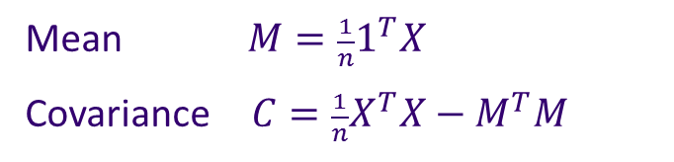
Covariance query: easy in LA, harder in RA
d attributes
$$X=$$
Mean $M=\frac{1}{n}1^{T}X$ Covariance $C=\frac{1}{n}X^{T}X−M^{T}M$
$$\left[\begin{matrix}x11 & x12 \\ x21 & x22 \\ x31 & x32\end{matrix}\right]$$
n points
LA
N = size(X, 1);
M = mean(X, 1);
C = X'*X / N – M'*M;
RA
(Generated SQL statements for each entry)
T = select from X sum(1.0) as N,
sum(X₁) as M₁, sum(X₂) as M₂, …, sum(X_{d}) as M_{d},
sum(X₁*X₁) as Q₁₁, sum(X₁*X₂) as Q₁₂, …,
sum(X_{d-1}*X_{d}) as Q_{(d-1)d}, sum(X_{d}*X_{d}) as Q_{dd}
C = select from T
(1 as i, 1 as j, Q₁₁/N – M₁*M₁ as v) union
(1 as i, 2 as j, Q₁₂/N – M₁*M₂ as v) union
…
Carlos Ordonez.
Building Statistical Models and Scoring with UDFs. SIGMOD 2007.
Notes:
Here is a covariance query on a data matrix with n d-dimensional points. The LA math equations for covariance are simple, and platforms like MATLAB realize them directly.
If we wanted to realize a covariance calculation in SQL instead, we would need to use techniques from a series of SIGMOD papers that generate large SQL queries like this.
Clearly the LA approach is the way to go.
This approach stores each column of the matrix X as a separate attribute.
Another approach is (I, j, v). We could use Lara to write the equations for this.
To prove that the MATLAB implements the LA, use: 1/n * (X – 1M)^{T}(X – 1M) = 1/n * X^{T}X – M^{T}M
Use n/(n-1) for bias correction.
U = X - repmat(M, N, 1);
C = U.' * U ./ (N - 1);
Bessel’s Correction for sample variance: N/(N – 1)

Slide 52
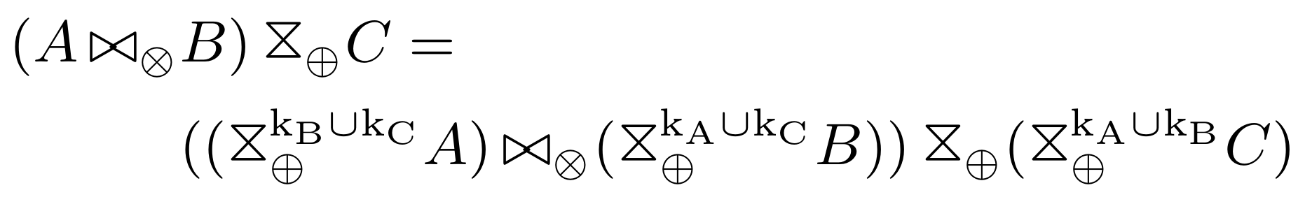
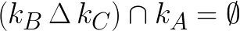
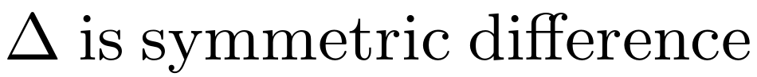
Lara Properties
If ⨁ or ⊗ is associative, commutative, or idempotent, then so is Union or Join
(Push Aggregation into Join) If ⊗ distributes over ⨁, then
(Distribute Join over Union) If , then
= sum(AB ⊗ C^{T})
Notes:
tr(XY) = sum(X ⊗ Y^{T})

Slide 53
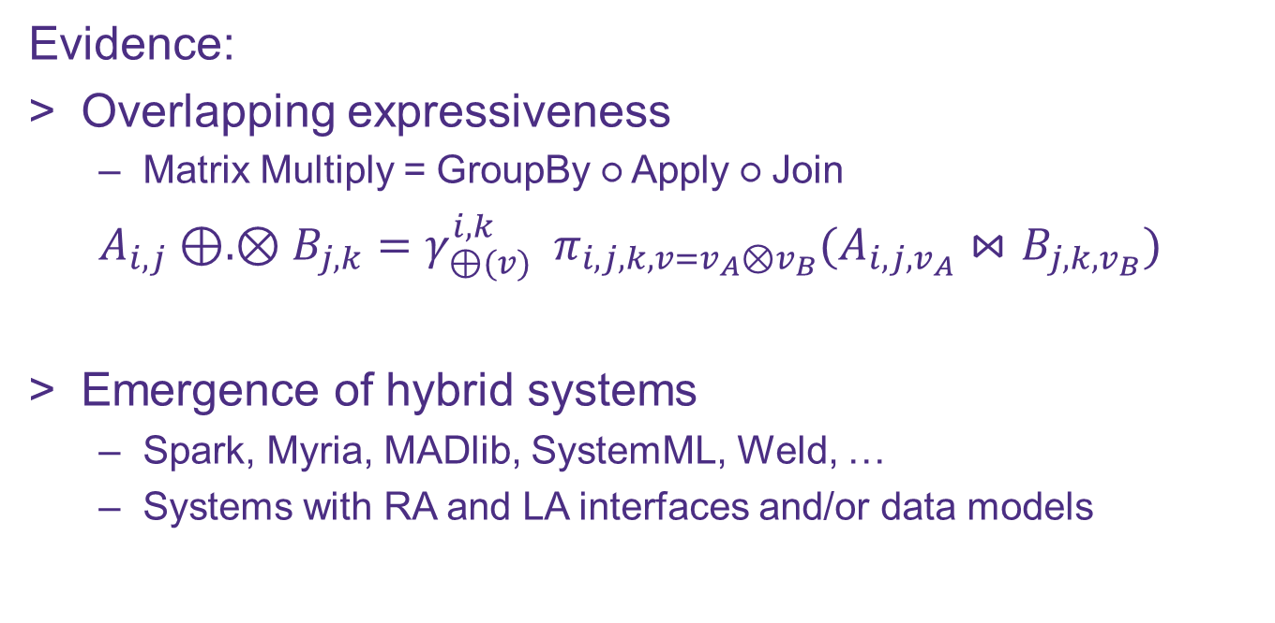
Is a common algebra possible?
Evidence:
Overlapping expressiveness
Matrix Multiply = GroupBy ○ Apply ○ Join
$$A_{i, j}⊕. ⊗B_{j, k}=γ_{⊕(v)}^{i, k} { π}_{i,j,k,v=v_{A}⊗v_{B}}(A_{i, j,v_{A}}⋈B_{j, k,v_{B}})$$
Emergence of hybrid systems
Spark, Myria, MADlib, SystemML, Weld, …
Systems with RA and LA interfaces and/or data models
Notes:
So with the previous evidence that there are tasks and properties that RA works well for but not LA and vice versa, could we even hope to unite these algebras?
The answer is yes, of course, because we all know that RA and LA have overlapping expressiveness, such as how MxM can be rewritten as a group-by-join,
and we’ve seen a surfeit of hybrid systems that span RA and LA.

Slide 54
LARA
Roadmap
⋈
⊕
⊗
Motivation: Sensor query
Sometimes RA is better, sometimes LA
Lara Algebra
3 Operators & Properties
LaraDB on Sorted Distributed Maps
Physical operators & optimizations
Experiments
Expressiveness: Lara affords impactful optimizations
Competitiveness: Lara affords competitive performance
Notes:
With that, we will now move our discussion onto the Lara algebra.
We’ll then present the setting of Sorted Distributed Maps, for which we lowered Lara to a physical algebra implemented in the Accumulo database.
Finally we’ll cover two experiments that show how a Lara implementation can afford impactful optimizations and competitive performance.

